Slide 1
Electrochemistry
General Chemistry II Chem2333

Slide 2
Electrochemistry outline
Module 5 – Session 2
Video 1: Components of the electrochemical cell
Video 2: notation of an electrochemical cell
Video 3: Understanding corrosion

Slide 3
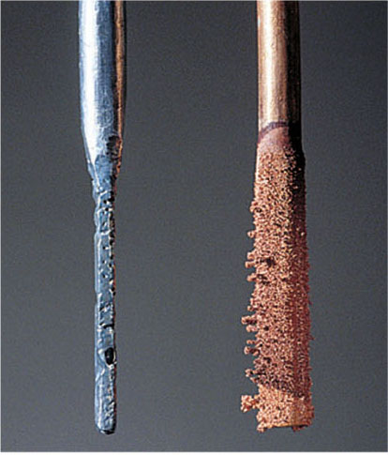
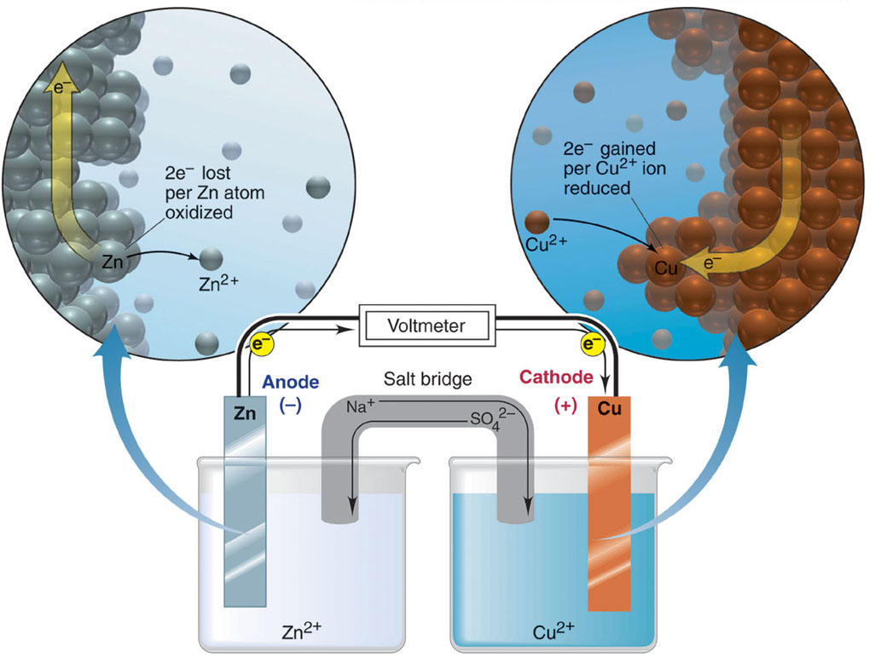
Electrochemical cell
Separating Half reactions: The Electrochemical Cell
Oxidation half-reaction
Zn(s) Zn²⁺(aq) + 2e⁻
Reduction half-reaction
Cu²⁺(aq) + 2e ⁻ Cu(s)
Overall (cell) reaction
Zn(s) + Cu²⁺(aq) Zn²⁺(aq) + Cu(s)
Notice:
The salt bridge
The spontaneity of the process
The net electric current The sign of the electrodes

Slide 4
Electrochemical cell: components of cell
→ Electrochemistry is the study of redox reactions that produce or require an electric current
→The conversion between chemical energy and electrical energy is carried out in an electrochemical cell
→Spontaneous redox reactions take place in a voltaic cell (or galvanic cells)
→Nonspontaneous redox reactions can be made to occur in an electrolytic cell by the external addition of electrical energy (e.g. electroplating)
Components of the Electrochemical Cell
An Ox
Anode Oxidation
Anode
electrode where oxidation occurs
Cathode
electrode where reduction occurs
Salt Bridge
is required to complete the circuit and maintain charge balance
Red Cat Reduction Cathode

Slide 5
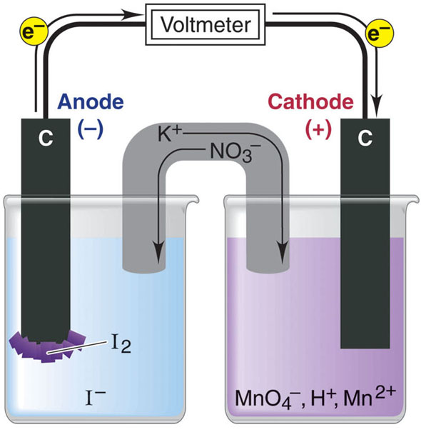
Electrochemical cell: components of cell
A salt bridge of KNO₃ connects the two solutions.
The purpose of the salt bridge in an electrochemical cell is:
to maintain electrical neutrality in the half-cells via migration of ions.
to provide a source of ions to react at the anode and cathode.
to provide oxygen to facilitate oxidation at the anode.
to provide a means for electrons to travel from the anode to the cathode.
to provide a means for electrons to travel from the cathode to the anode.

Slide 6
Electrochemical cell: components of cell
Which transformation could take place at the anode of an electrochemical cell?
NO → NO₃–
VO₂⁺ → VO²⁺
O₂ → H₂O₂
All of the above would function as cathodes
All of the above would function as anodes

Slide 7
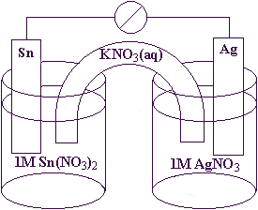
Electrochemical cell: direction of electrons and ions
Consider the electrochemical cell diagram shown below. As you observe the reaction in the cell, you notice that the tin electrode seems to be disappearing while there are deposits forming on the silver electrode.
Identify the Anode and the Cathode
Describe the direction of electron flow. From what electrode?
What beaker will be losing negative charge? Where will NO₃⁻ ions from the salt bridge be flowing in?

Slide 8
Electrochemical cell: notation
Notation for a Voltaic Cell
Zn(s) Zn²⁺(aq) + 2e⁻
Cu²⁺(aq) + 2e⁻ Cu(s)
Zn(s) | Zn²⁺(aq) || Cu²⁺(aq) | Cu (s)
phase boundary between half-cells
components of anode compartment
(oxidation half-cell)
components of cathode compartment
(reduction half-cell)
phase of lower oxidation state
phase of higher oxidation state
phase of higher oxidation state
phase of lower oxidation state

Slide 9
Electrochemical cell: notation
Draw the scheme of the following galvanic or electrochemical cell
graphite | I⁻(aq) | I₂(s) || H⁺(aq), MnO₄⁻(aq) | Mn²⁺(aq) | graphite
inert electrode

Slide 10
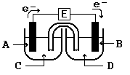
Electrochemical cell: direction of electrons and ions
In the diagram, identify the materials needed to make the anode and the cathode in a galvanic cell based on the chemical reaction between aluminum metal and silver ions. Al(s) + 3 Ag(aq) → Al³⁺(aq) + 3 Ag(s)
Metal A is _______________.
Metal B is _______________.
Solution C contains _______________.
Solution D contains _______________.

Slide 11
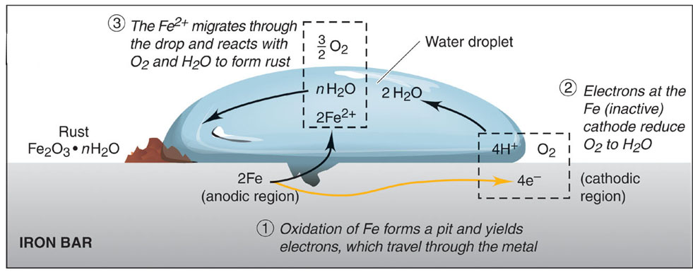
Electrochemical cell: Corrosion
Identify the Anode and Cathode in this picture
And the flow of electrons.

Slide 12
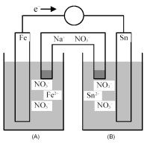
Electrochemical cell: direction of electrons and ions
Write the overall balanced redox reaction taking place in this battery

Slide 13
Exam question.
For each of the reactions below write balanced half-reactions. The half-reaction do not need to include “spectator ions”.
AgNO₃(aq) + Al(s) → Ag(s) + Al[NO₃]₃
Reduction half-reaction (include electrons)
Oxidation half-reaction (include electrons)
Na + H₂O → NaOH + H₂
Reduction half-reaction (include electrons)
Oxidation half-reaction (include electrons)
Au₂[SO₄]₃ + Sn → Au₂[SO₄] + Sn[SO₄]
Reduction half-reaction (include electrons)
Oxidation half-reaction (include electrons)

