Slide 1
Electrochemistry
General Chemistry II Chem2333

Slide 2
Electrochemistry outline
Module 5 – Session 2
Video 1: Components of the electrochemical cell
Video 2: notation of an electrochemical cell
Video 3: Understanding corrosion

Slide 3
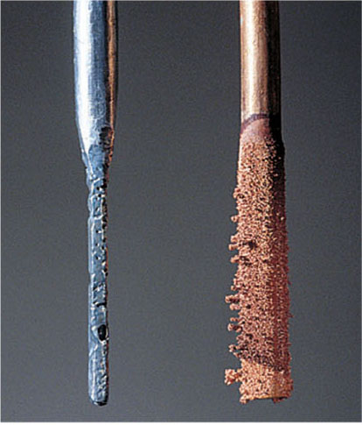
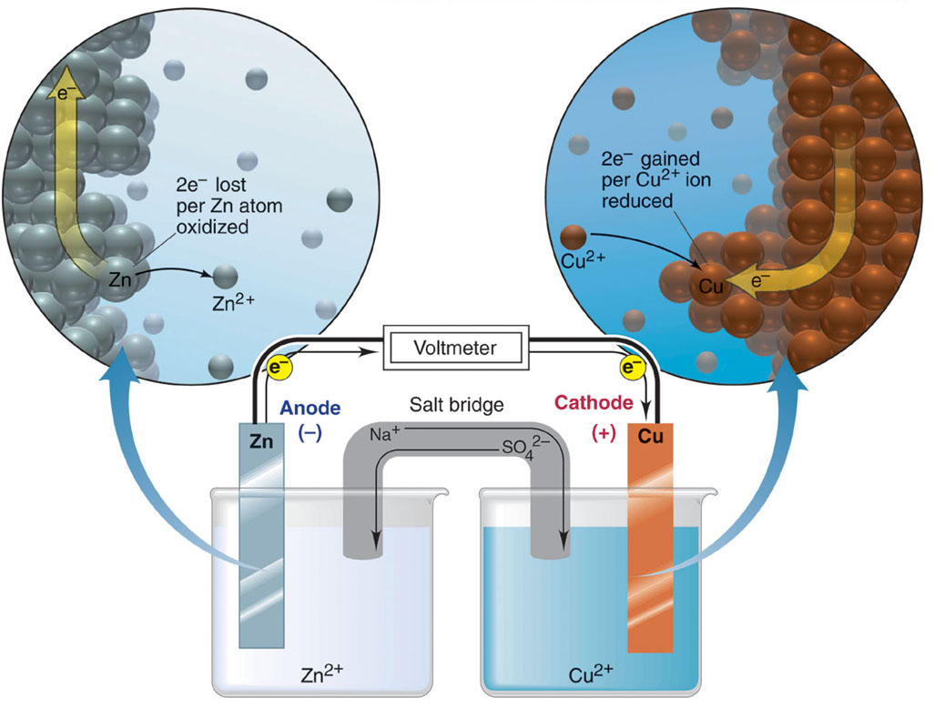
Electrochemical cell
Separating Half reactions: The Electrochemical Cell
Oxidation half-reaction
Zn(s) Zn²⁺(aq) + 2e⁻
Reduction half-reaction
Cu²⁺(aq) + 2e ⁻ Cu(s)
Overall (cell) reaction
Zn(s) + Cu²⁺(aq) Zn²⁺(aq) + Cu(s)
Notice:
The salt bridge
The spontaneity of the process
The net electric current The sign of the electrodes

Slide 4
Electrochemical cell: components of cell
→ Electrochemistry is the study of redox reactions that produce or require an electric current
→The conversion between chemical energy and electrical energy is carried out in an electrochemical cell
→Spontaneous redox reactions take place in a voltaic cell (or galvanic cells)
→Nonspontaneous redox reactions can be made to occur in an electrolytic cell by the external addition of electrical energy (e.g. electroplating)
Components of the Electrochemical Cell
An Ox
Anode Oxidation
Anode
electrode where oxidation occurs
Cathode
electrode where reduction occurs
Salt Bridge
is required to complete the circuit and maintain charge balance
Red Cat Reduction Cathode

Slide 5
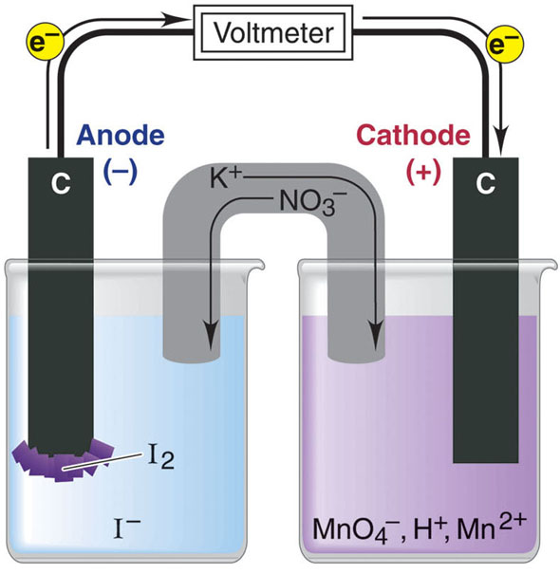
Electrochemical cell: components of cell
A voltaic cell using inactive electrodes.
Write each half-reaction and assign which one happens in the anode and which in the cathode
Inert electrodes:
While conducting electricity they are not involved in the reaction
Overall (cell) reaction
2MnO₄⁻(aq) + 16H⁺(aq) + 10I⁻(aq) 2Mn²⁺(aq) + 5I₂(s) + 8H₂O(l)

Slide 7
Electrochemical cell: notation
Notation for a Voltaic Cell
Zn(s) Zn²⁺(aq) + 2e⁻
Cu²⁺(aq) + 2e⁻ Cu(s)
Zn(s) | Zn²⁺(aq) || Cu²⁺(aq) | Cu (s)
phase boundary between half-cells
components of anode compartment
(oxidation half-cell)
components of cathode compartment
(reduction half-cell)
phase of lower oxidation state
phase of higher oxidation state
phase of higher oxidation state
phase of lower oxidation state

Slide 8
Electrochemical cell: notation
What is the reducing agent in the following electrochemical cell?
Ni (s) | Ni²⁺ (aq) || Ag⁺ (aq) | Ag (s)
Ni
Ni²⁺
Ag
Ag⁺
There is no reducing agent in an electrochemical cell.

Slide 9
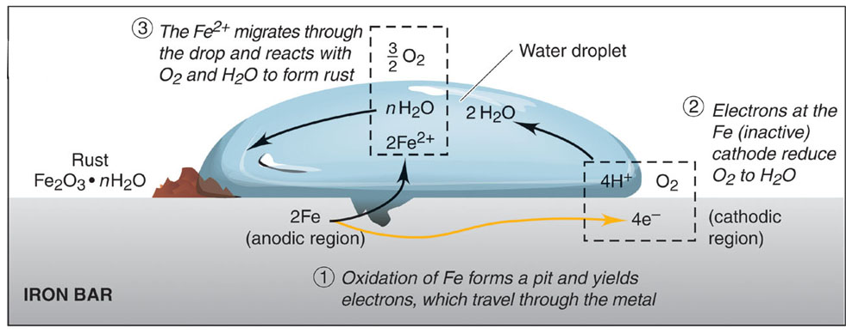
Electrochemical cell: Corrosion
Identify the Anode and Cathode in this picture
And the flow of electrons.

Slide 10
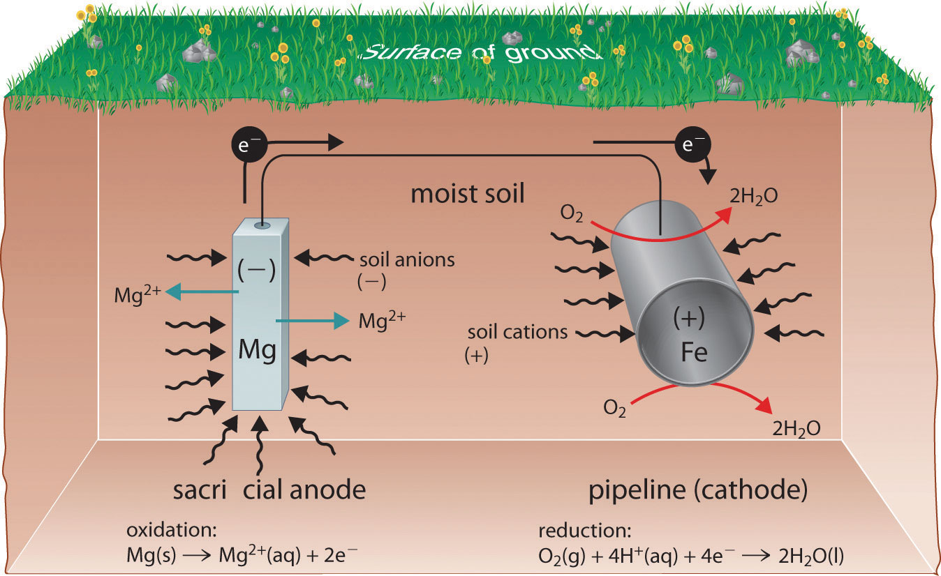
Electrochemical cell: Corrosion
A sacrificial anode is a metal that oxidizes more easily than iron and therefore protects iron from rusting.

