Slide 1

Electrochemistry
General Chemistry II Chem2333

Slide 2
Electrochemistry outline
Module 5 – Session 3
Video 1: Electric potential is related to Gibbs free energy
  Conceptual understanding of voltage and current.
  Units: Faraday constant is the charge of one mole of electrons
Video 2: Reference potential to measure half-reaction potentials
  Standard Hydrogen Electrode is an arbitrary choice
  Reduction potentials give a sense of how likely a species is
  willing to accept electrons.
Video 3: Calculating the cell potential from two half-reactions
Video 4: Standard cell potential and spontaneity

Slide 3
Cell potential and free energy
For the reaction
2 Al(s) + 3 Co²⁺(aq) → 2 Al³⁺(aq) + 3 Co(s), ΔG° is -799 kJ.
What is E° for a standard cell based on this reaction?
Is it spontaneous?
Volts are Joules/coloumb, being coulomb the unit of charge.
How many joules did the battery consume after one million electrons are exchanged between the cathode and the anode?
(the charge of one electron is 1.6E-19 coulombs.)
How many grams of cobalt are accumulated in the anode/cathode?
If this magnitude is standard, what are the concentrations of Co(2+) and Al(3+) in this battery?
Why will ΔG° change if we balance the reaction differently but not Eº?

Slide 4
Qualitative understanding of Eº
Standard reduction potentials reflect the tendency of a species to gain electrons.
Rank without looking at any data table the following species in standard reduction
potential.
Eº_{Na+/Na}
Eº_{Li+/Li}
Eº_{Cl2/Cl-}
Eº_{F2/F-}

Slide 5
Potential of half reactions and standard cell potential
Sample Problem 21.3
Calculating an Unknown Eº_{half-cell} from Eº_{cell}
PROBLEM:
A voltaic cell houses the reaction between aqueous bromine and zinc metal:
Br₂(aq) + Zn(s) Zn²⁺(aq) + 2Br⁻(aq) Eº_{cell} = 1.83 V
Calculate Eº_{bromine} given Eº_{zinc} = −0.76 V
Note:
Remember that all electrode potentials are defined as reductions. So you need to change the sign of the oxidation
E°_{cell} = E°_{reduction} + E°_{oxidation}
  when adding E° values for the half-cells, do not multiply the half-cell E° values, even if you need to multiply the half-reactions to balance the equation

Slide 6
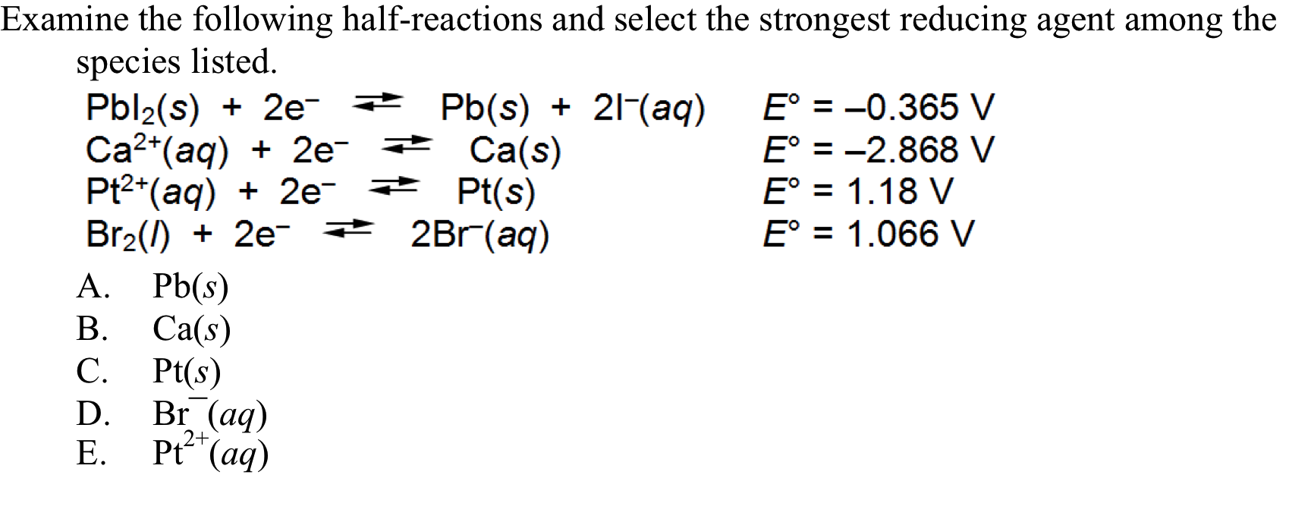
Relative strength of oxidizing and reducing agent

Slide 7
Exam problem
a) What species in the above table can be spontaneously reduced by Silver solid?
b) What species in the above table can be spontaneously oxidized by Copper(II)?
c) An electrode of aluminum and an electrode of copper are placed in solutions of AlCl₃ and CuCl₂, respectively. The electrodes are connected with a metallic wire and the solutions with a salt bridge. Write the overall reaction and calculate the standard free energy associated to the overall reaction.

Slide 8
Spontaneity and cell potential
We build a cell with I₂(s)/I⁻ in one electrode and Al/A^{l3+} in the other.
What is ΔGº for the cell given the following reduction potentials? Balance the reaction with the least common multiple of electrons
I₂ (s) + 2 e– → 2 I– (aq) 0.54V
Al³⁺ (aq) + 3 e– → Al (s) –1.66V
636 kJ / mol
–648 kJ/ mol
–216 kJ/ mol
–636 kJ/ mol
–1270 kJ/ mol
Iodine is a halogen and Aluminum a half-metal.
Can you predict which of the two would get electrons and which would give them?

Slide 9
Fun quizzes: setup a battery
Knowing the following values
Fe³⁺ + 1e- → Fe²⁺ Eº = 0.77V ; Cu²⁺ + 1e- → Cu⁺ Eº = 0.16V
Fe²⁺ + 2e- → Fe Eº = -0.44V ; Cu⁺ + 1e- → Cu Eº = 0.52V
Fe³⁺ + 3e- → Fe Eº = -0.04V ; Cu²⁺ + 2e- → Cu Eº = 0.34V
We setup a functioning battery containing the following parts
An iron electrode inside a solution containing 1M FeCl₃ and 1M FeCl₂
A copper electrode inside a solution containing 1M CuCl₂
A salt bridge with KCl connecting both solutions
A conducting wire connects the iron and the copper electrode
Iron electrode is the anode
The electrons flow from the copper electrode to the iron electrode
The cations of the salt bridge will flow into the anode
As the reaction proceeds copper solid accumulates in the anode

Slide 10
Cell potential. Practice
Use the following table to answer the questions:
http://www.chemeddl.org/services/moodle/media/QBank/GenChem/Tables/EStandardTable.htm
1. Calculate Eº for the following balanced reaction.
Cu + Cl₂ → CuCl₂
-2.383 V
-1.021 V
1.021 V
1.695 V
2.379 V
2. Calculate Eº for the following balanced reaction.
2AgI + Ca → 2Ag +CaI₂
-3.02 V
3.02 V
2.72 V
-2.72 V
2.57 V
3. Calculate Eº for the following balanced reaction.
Te(s) + 2H₂O(l) + 2Sn⁺⁴(aq) TeO₂(s) + 4H⁺(aq) + 2Sn⁺²(aq)
Choose one answer.
0.229 V
0.379 V
-0.379 V
0.679 V
-0.229 V
4. Calculate Eº for the following balanced reaction.
N₂H₅⁺(aq) + 2Cu⁺(aq) + 3H⁺(aq) → 2Cu⁺²(aq) + 2NH₄⁺(aq)
Choose one answer.
-0.934 V
-1.087 V
1.087 V
1.393 V
0.934 V

Slide 11
Cell potential. Practice
Sample Problem 21.4:
Writing Spontaneous Redox Reactions and Ranking Oxidizing and Reducing Agents by Strength
PROBLEM:
(a) Combine the following three half-reactions into three balanced equations (A, B, and C) for spontaneous reactions, and calculate Eº_{cell} for each.
(b) Rank the relative strengths of the oxidizing and reducing agents:
(1) NO₃⁻(aq) + 4H⁺(aq) + 3e⁻ NO(g) + 2H₂O(l)
Eº = 0.96 V
(2) N₂(g) + 5H⁺(aq) + 4e⁻ N₂H₅⁺(aq)
Eº = -0.23 V
(3) MnO₂(s) +4H⁺(aq) + 2e⁻ Mn²⁺(aq) + 2H₂O(l)
Eº = 1.23 V
PLAN:
Put the equations together in varying combinations so as to produce (+) Eº_{cell} for the combination. Since the reactions are written as reductions, remember that as you reverse one reaction for an oxidation, reverse the sign of Eº. Balance the number of electrons gained and lost without changing the Eº.
In ranking the strengths, compare the combinations in terms of Eº_{cell}.

