Slide 1

Electrochemistry
General Chemistry II Chem2333

Slide 2
Electrochemistry outline
Module 5 – Session 3
Video 1: Electric potential is related to Gibbs free energy
  Conceptual understanding of voltage and current.
  Units: Faraday constant is the charge of one mole of electrons
Video 2: Reference potential to measure half-reaction potentials
  Standard Hydrogen Electrode is an arbitrary choice
  Reduction potentials give a sense of how likely a species is
  willing to accept electrons.
Video 3: Calculating the cell potential from two half-reactions
Video 4: Standard cell potential and spontaneity

Slide 3
Cell potential
Magnitudes to study Electrochemical reactions
ATP⁴⁻(aq) + H₂O ADP³⁻(aq) + HPO₄²⁻ (aq) + H⁺(aq) ΔGº = -30.5kJ/mol
Why is it divided per mol? Does this value depend on how it is balanced?
We need to quantify how much energy we get every time the reaction happens
ΔGº = -nFE⁰
n: number of electrons
F: Faraday constant 96 485.3415 Coulombs
E⁰: Electric cell potential. Units in Volts (Joules /Coulomb)
Unit of charge: Coulomb
1 electron has −1.602×10−19 coulombs

Slide 4
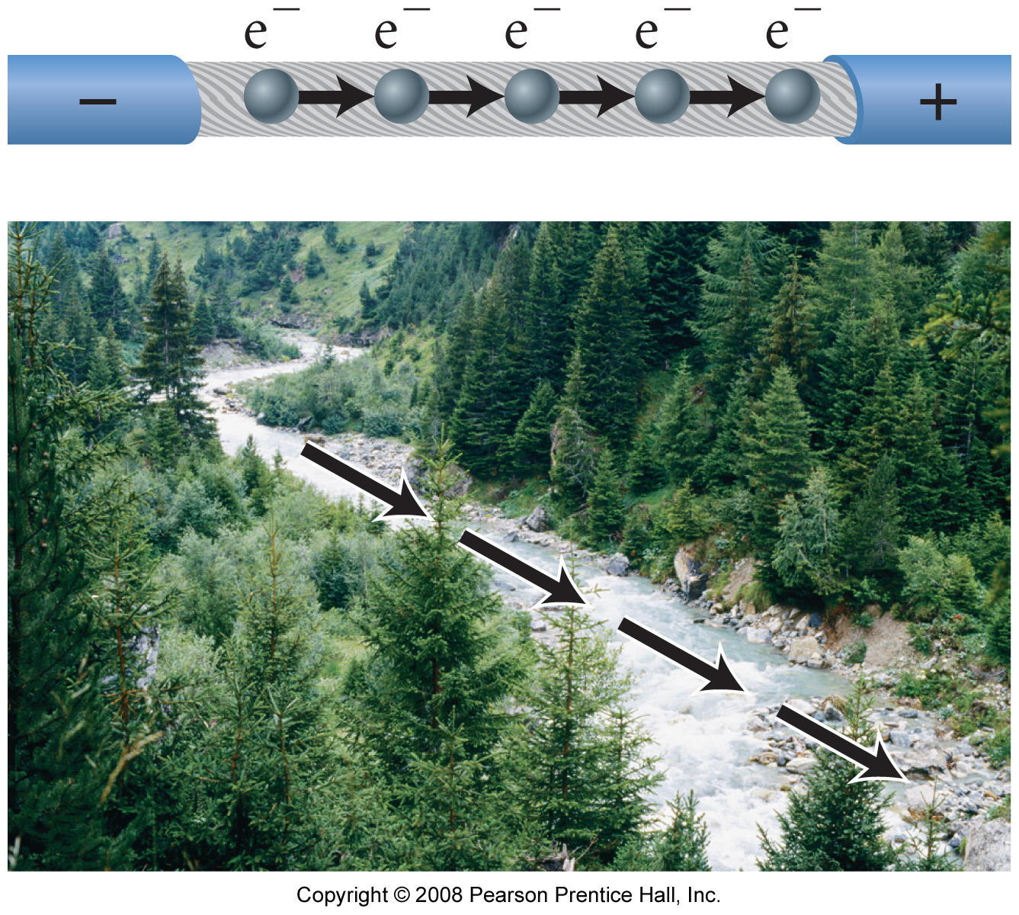
Units of charge and units of potential
Electric Property | Electric Potential /Voltage | Current / Intensity
Description | The force with which electrons are being pushed | The number of electrons that flow per unit of time
Units | Volts: Joules/coulomb | Ampere: coulomb/second
River Metaphor | Slope. Difference in height. | Volume of flow per second

Slide 5
Voltages of some voltaic cells
The same way that there are more or less energetic reactions
now we have redox reactions with more or less voltage
Voltaic Cell
Voltage (V)
Common alkaline flashlight battery
1.5
Lead-acid car battery (6 cells = 12 V)
2.0
Calculator battery (mercury)
1.3
Lithium-ion laptop battery
3.7
Electric eel (~5000 cells in 6-ft eel = 750 V)
0.15
Nerve of giant squid (across cell membrane)
0.070
Human nerve cell
0.030
http://outreach.mcb.harvard.edu/animations/actionpotential_short.swf

Slide 6
Cell potential
→Instead of energy per mol. Now we are interested in energy per unit of charge.
Electric potential can be easily measured by a voltmeter.
Mg (s) + Cu²⁺ (aq) → Cu (s) + Mg²⁺ (aq)
E⁰ = 2.04 V
→Calculate the ΔGº of this reaction?
→How much solid copper is formed after this reaction proceeds during 10 seconds at a
steady current 0.5 amperes?

Slide 7
Potential of half reactions and standard cell potential
Since the half reactions happen in different electrodes. Can we measure E for each electrode?
We can only measure overall cell potentials. Oxidation + Reduction
Overall (cell) reaction
Zn(s) + 2H₃O⁺(aq) Zn²⁺(aq) + H₂(g) + 2H₂O(l)
E = 0.76 V
Oxidation half-reaction
Zn(s) Zn²⁺(aq) + 2e⁻
The reduction of H⁺ at 1M is arbitrarily set to
E = 0 V
Reduction half-reaction
2H₃O⁺(aq) + 2e⁻ H₂(g) + 2H₂O(l)
Eº_{cell} = Eº_{cathode(reduction)} + Eº_{anode(oxidation)} = 0 + 0.76 = 0.76V
Wait:
One redox half-reaction cannot happen alone.
We need to maesure Eº by comparing it to another reaction/electrode
The same way that we need ΔH_{f} and ΔG_{f} of formation in Thermodynamics;
now we need a Standard Electrode Potential from which all other reactions are measured.
standard reference (hydrogen) electrode

Slide 8
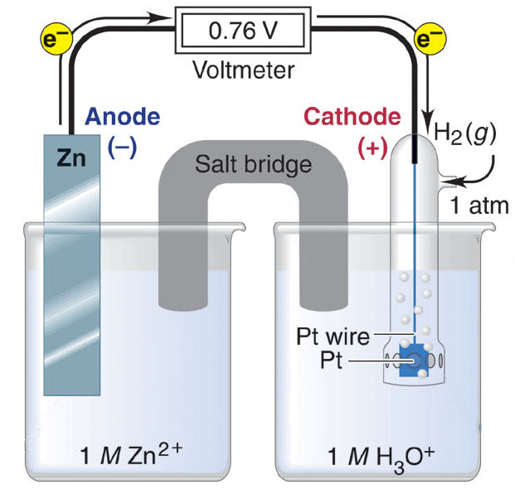
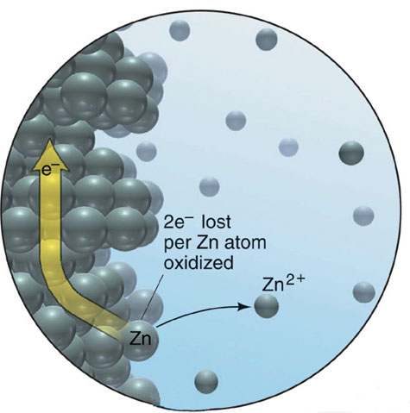
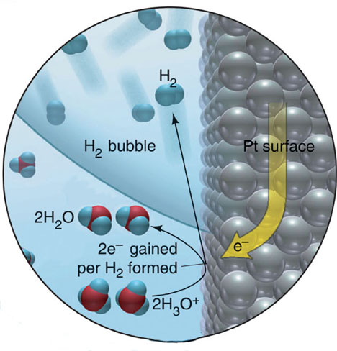
Potential of half reactions and standard cell potential
Determining an unknown Eº_{half-cell} with the standard reference (hydrogen) electrode.
Oxidation half-reaction
Zn(s) Zn²⁺(aq) + 2e⁻
Reduction half-reaction
2H₃O⁺(aq) + 2e⁻ H₂(g) + 2H₂O(l)
Overall (cell) reaction
Zn(s) + 2H₃O⁺(aq) Zn²⁺(aq) + H₂(g) + 2H₂O(l)
Notice that the concentration is constant and p=1atm
Eº_{cell} = Eº_{cathode(reduction)} + Eº_{anode(oxidation)} = 0 + 0.76 = 0.76V

Slide 9
Potential of half reactions and standard cell potential
Table 21.2 Selected Standard Electrode Potentials (298K)
Notice that these are Half-Reactions
Half-reactions never happen alone
Eº(V)
F₂(g) + 2e ⁻ 2F⁻(aq)
+2.87
Cl₂(g) + 2e⁻ 2Cl⁻(aq)
+1.36
MnO₂(g) + 4H⁺(aq) + 2e⁻ Mn²⁺(aq) + 2H₂O(l)
+1.23
NO₃⁻(aq) + 4H⁺(aq) + 3e⁻ NO(g) + 2H₂O(l)
+0.96
Ag⁺(aq) + e⁻ Ag(s)
+0.80
Fe³⁺(g) + e⁻ Fe²⁺(aq)
+0.77
O₂(g) + 2H₂O(l) + 4e⁻ 4OH⁻(aq)
+0.40
strength of reducing agent
Cu²⁺(aq) + 2e⁻ Cu(s)
+0.34
strength of oxidizing agent
2H⁺(aq) + 2e⁻ H₂(g)
0.00
N₂(g) + 5H⁺(aq) + 4e⁻ N₂H₅⁺(aq)
−0.23
Fe²⁺(aq) + 2e⁻ Fe(s)
−0.44
2H₂O(l) + 2e⁻ H₂(g) + 2OH⁻(aq)
−0.83
Na⁺(aq) + e⁻ Na(s)
−2.71
Li⁺(aq) + e⁻ Li(s)
−3.05
Conventionally all electrode potentials are represented as reductions

Slide 10
Relative strength of oxidizing and reducing agent
Why does F2 have such high reduction potential and alkali metals are negative?
Which of the following is the best reducing agent?
Ni²⁺
Ni
Zn
Ag
Ni²⁺ (aq) + 2 e⁻ → Ni (s) −0.23 V
Zn²⁺ (aq) + 2 e⁻ → Zn (s) −0.76 V
Ag⁺ (aq) + e⁻ → Ag (s) 0.80 V

Slide 11
Potential of half reactions and standard cell potential
http://www.chemeddl.org/services/moodle/media/QBank/GenChem/Tables/EStandardTable.htm
For a spontaneous process:
E_{cell} > 0
“the river needs to have
a downhill slope”
if the two of them
are reduction potentials. You need to reverse the oxidation reaction.
Eº_{cell} = Eº_{cathode(reduction)} – Eº_{anode(oxidation)}
Careful:
In tables, by convention Eº always refers to the reduction reaction.
Pay attention to what reaction Eº is referring
if the second potential
is already an oxidation
Eº_{cell} = Eº_{cathode(reduction)} + Eº_{anode(oxidation)}

Slide 12
Potential of half reactions and standard cell potential
Calculate the cell potential for the following reaction under standard conditions:
Mg (s) + Cu²⁺ (aq) → Cu (s) + Mg²⁺ (aq)
+2.04
−2.04
+2.71
–1.36
+1.36
Cu²⁺ (aq) + 2 e⁻ → Cu (s) 0.34 V
Mg²⁺ (aq) + 2 e⁻ → Mg (s) −2.37 V

Slide 13
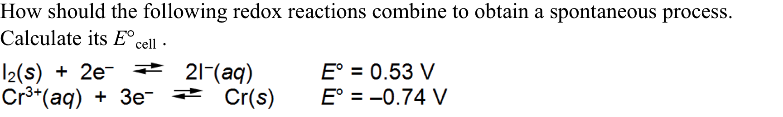
Spontaneity and cell potential
For a spontaneous process:
E_{cell} > 0

