Slide 1
Electrochemistry
General Chemistry II Chem2333

Slide 2
Outline
Module 5 – Session 4
Video 1: Effect of concentration on cell potential
Nernst equation
Video 2: Nernst equation and equilibrium
Values for E, Eº, K, Q at different situations
Video 3: Concentratrion cells

Slide 3
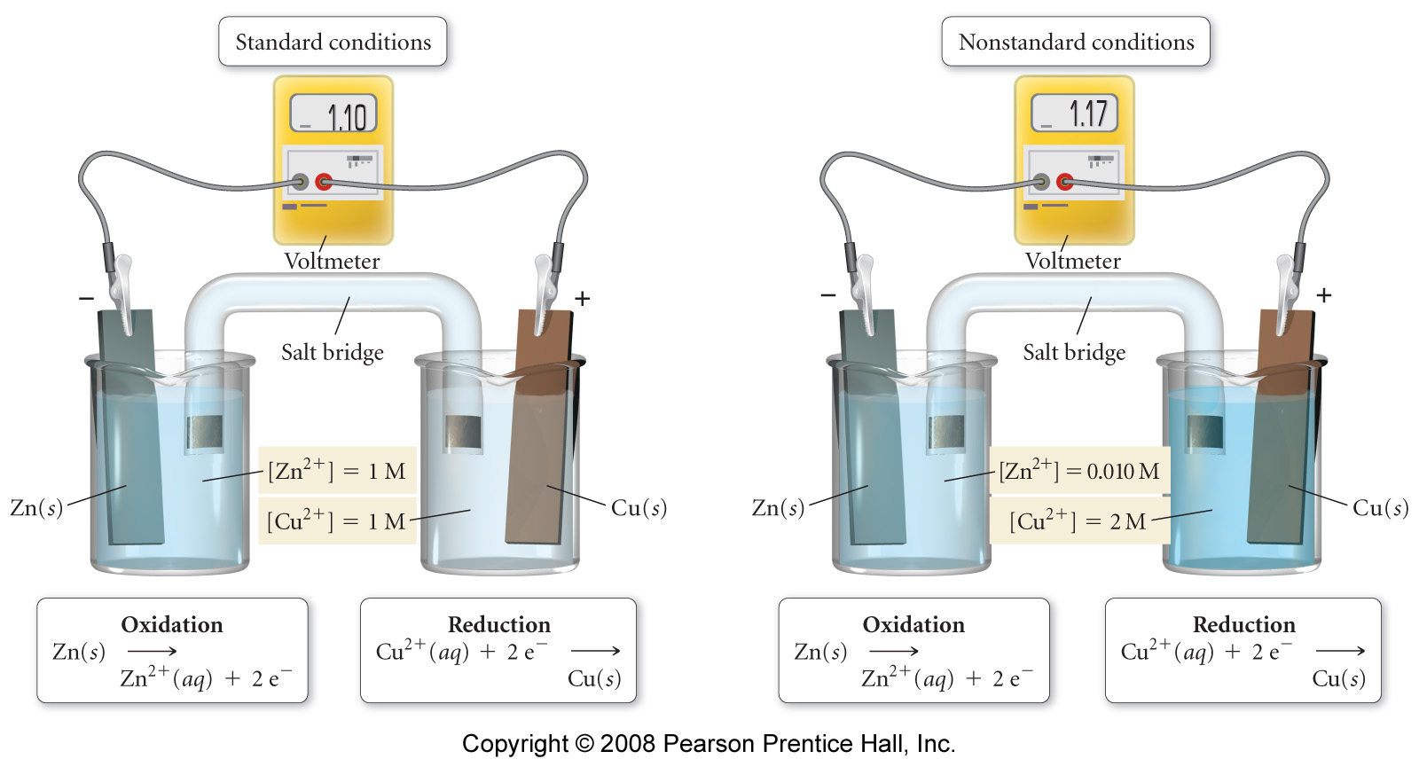
Free energy and standard cell potential
We can observe how the measured electric potential of a battery changes with concentration
Write down the overall reaction taking place.
If we look at the concentrations on the right: Are we adding more reactants or more products with respect to standard concentrations (1M each)?
Is the potential increasing or decreasing?

Slide 4
Free energy and standard cell potential
In thermodynamics we learned that the Gibbs Free Energy gives us the criteria for the spontaneity of the process
ΔG° = ΔH° - TΔS°
Influence of temperature
ΔG = ΔG° + RT lnQ
Influence of concentrations and T
In equilibrium the “instant free energy” is zero and Q=K
0 = ΔG° + RTlnK → ΔG° = -RT lnK
Because of the equivalence between free energy and cell potential, we can write similar equations
n: number of electrons
F: Faraday constant 96 485.3415 Coulombs
E⁰: Electric cell potential. Units in Volts (Joules /Coulomb)
ΔG° = -nFEº
-nFE_{cell} = -nFEº_{cell} + RT ln Q
RT
The Nernst equation
E_{cell} = Eº_{cell} -
ln Q
nF

Slide 5
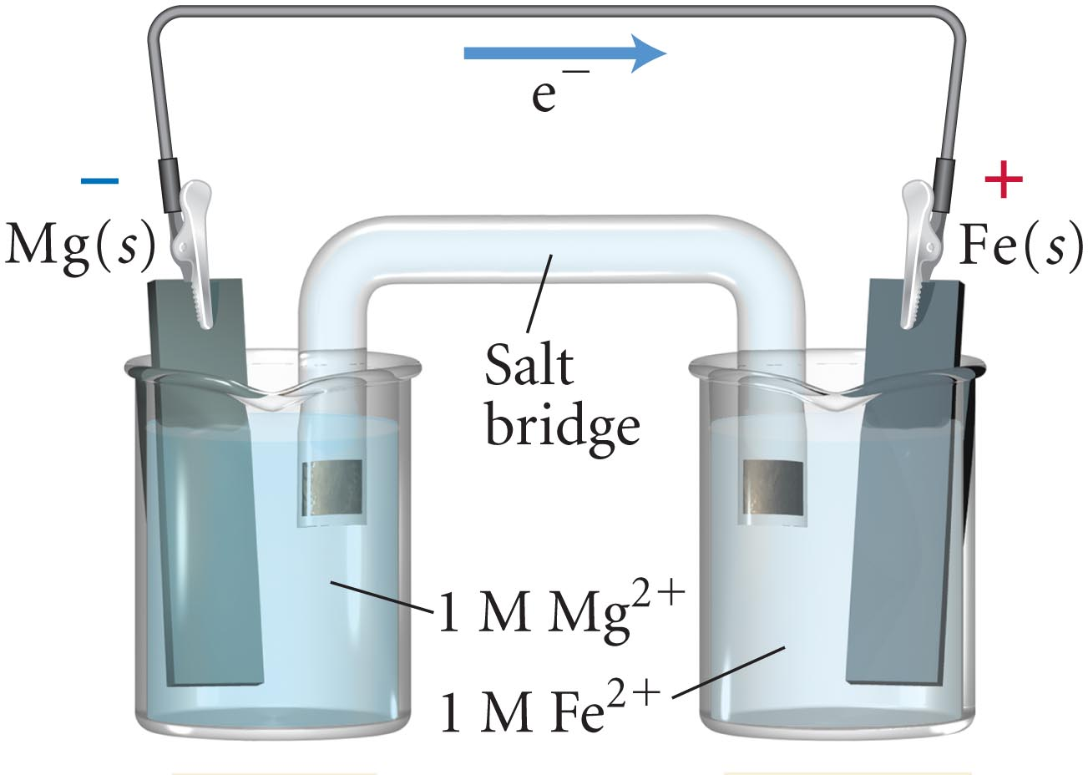
Nernst equation
Calculate the cell potential (E_{cell}) of an electrochemical cell at 298 K with Mg/Mg²⁺ and Fe/Fe²⁺ electrodes. [Mg²⁺] = 0.200 M and [Fe²⁺] = 0.050 M.
Fe²⁺ (aq) + 2 e– → Fe (s) E⁰ = –0.45V
Mg²⁺ (aq) + 2 e– → Mg (s) E⁰ = –2.37V

Slide 6
Exam problem

Slide 7
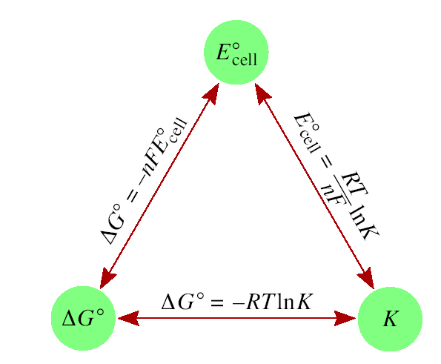
Nernst equation: Q, K, E, Eº, ΔG and ΔGº
RT
E_{cell} = Eº_{cell} -
ln Q
nF
In equilibrium E_{cell} = 0, Q = K
RT
Eº_{cell} = -
ln K
nF
Fill the following table assigning the criteria for spontaneity
 | ΔGº | Eº | K
Spontaneous
Non-Spontaneous

Slide 8
True/False
When Eº is smaller than one, K is always smaller than one
When ΔG is negative it implies that there Q is smaller than one.
When a battery dies. Eº is zero
When a battery dies. Q = 1
If E is negative, the electrochemical reaction will proceed forward until it becomes zero.

Slide 9
Free energy and standard cell potential
Based on the given information
Fe²⁺ (aq) + 2 e– → Fe (s) E⁰ = –0.45V
Mg²⁺ (aq) + 2 e– → Mg (s) E⁰ = –2.37V
Calculate Eºcell
Calculate ΔGº
A dead battery will have its concentrations in equilibrium
What are the concentrations in equilibrium?
What is the measured potential in equilibrium?
If after the battery is dead
What happens if we add some Fe²⁺ to the cathode?
Will Q > K or Q < K?
What will be the sign of the potential?

Slide 10
Free energy and standard cell potential
Calculate the equilibrium constant, K, at 25°C for the galvanic cell reaction shown below:
Before doing any calculation. Do you expect K to be larger or smaller than one?

Slide 11
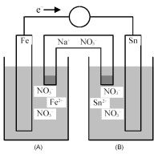
Nernst equation
Answer the following questions for the battery given in the diagram:
Write the overall reaction
What happens to the cell potential when we add iron(II) nitrate on the cathode?
What happens to the standard cell potential when we add tin (II) chloride on the cathode?
What happens to the cell potential when we add iron (II) chloride on the anode?
What happens to the cell potential when we add thinly ground solid iron in the anode?

Slide 12
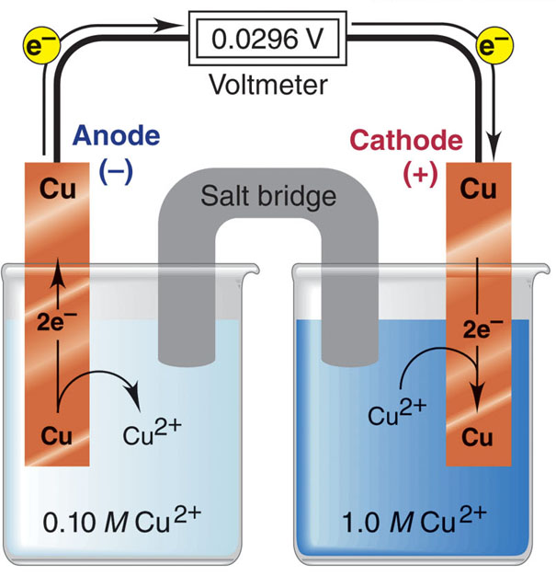
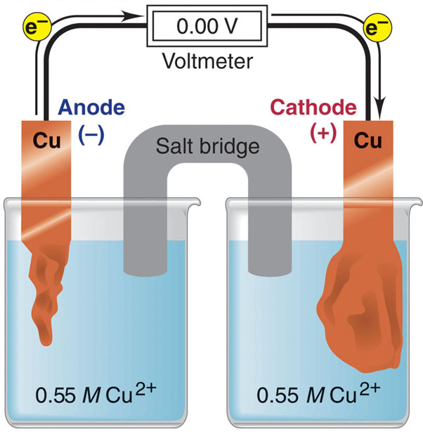
Concentration cells
You have two beakers. Both with CuCl₂. One [CuCl₂] = 0.1M and another at [CuCl₂] = 1.M. When we sink two copper electrodes we measure electric current. What reaction is happening on each of the beakers? When will it stop?

Slide 13
Concentration cells
A concentration cell consists of two Al/Al³⁺ electrodes. The electrolyte in compartment A is 0.050 M Al(NO₃)₃ and in compartment B is 1.25 M Al(NO₃)₃. What is the voltage of the cell at 25ºC?
Draw a scheme of this concentration cell
Indicate the direction of flow of electrons
Indicate the anode and the cathode
Indicate the electrode that will increase its mass
Calculate the voltage at 25 Celsius.
Calculate the concentrations of ions in equilibrium

