Slide 1
Electrochemistry
General Chemistry II Chem2333

Slide 2
Outline
Module 5 – Session 4
Video 1: Effect of concentration on cell potential
Nernst equation
Video 2: Nernst equation and equilibrium
Values for E, Eº, K, Q at different situations
Video 3: Concentratrion cells

Slide 3
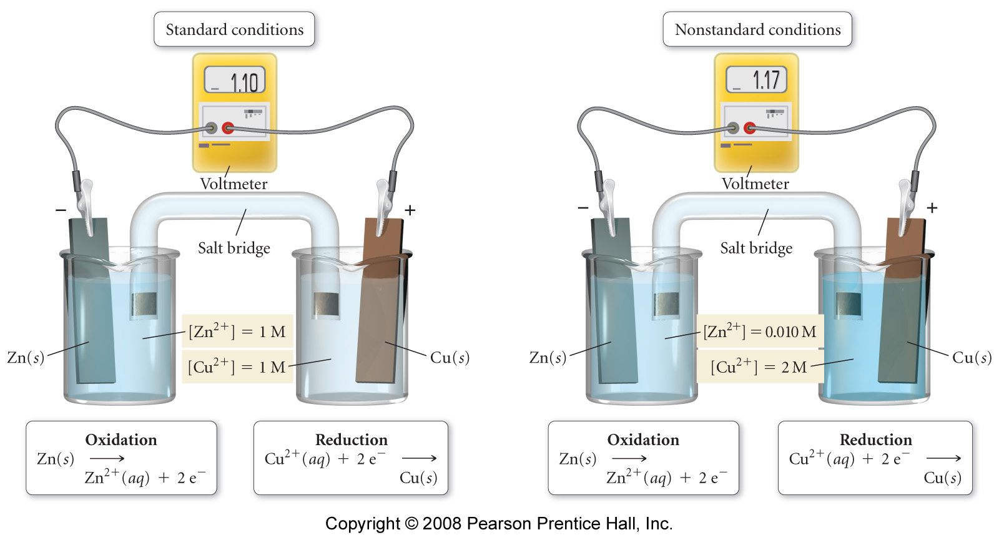
Free energy and standard cell potential
We can observe how the measured electric potential of a battery changes with concentration
Write down the overall reaction taking place.
If we look at the concentrations on the right: Are we adding more reactants or more products with respect to standard concentrations (1M each)?
Is the potential increasing or decreasing?

Slide 4
Free energy and standard cell potential
In thermodynamics we learned that the Gibbs Free Energy gives us the criteria for the spontaneity of the process
ΔG° = ΔH° - TΔS°
Influence of temperature
ΔG = ΔG° + RT lnQ
Influence of concentrations and T
In equilibrium the “instant free energy” is zero and Q=K
0 = ΔG° + RTlnK → ΔG° = -RT lnK
Because of the equivalence between free energy and cell potential, we can write similar equations
n: number of electrons
F: Faraday constant 96 485.3415 Coulombs
E⁰: Electric cell potential. Units in Volts (Joules /Coulomb)
ΔG° = -nFEº
-nFE_{cell} = -nFEº_{cell} + RT ln Q
RT
The Nernst equation
E_{cell} = Eº_{cell} -
ln Q
nF

Slide 5
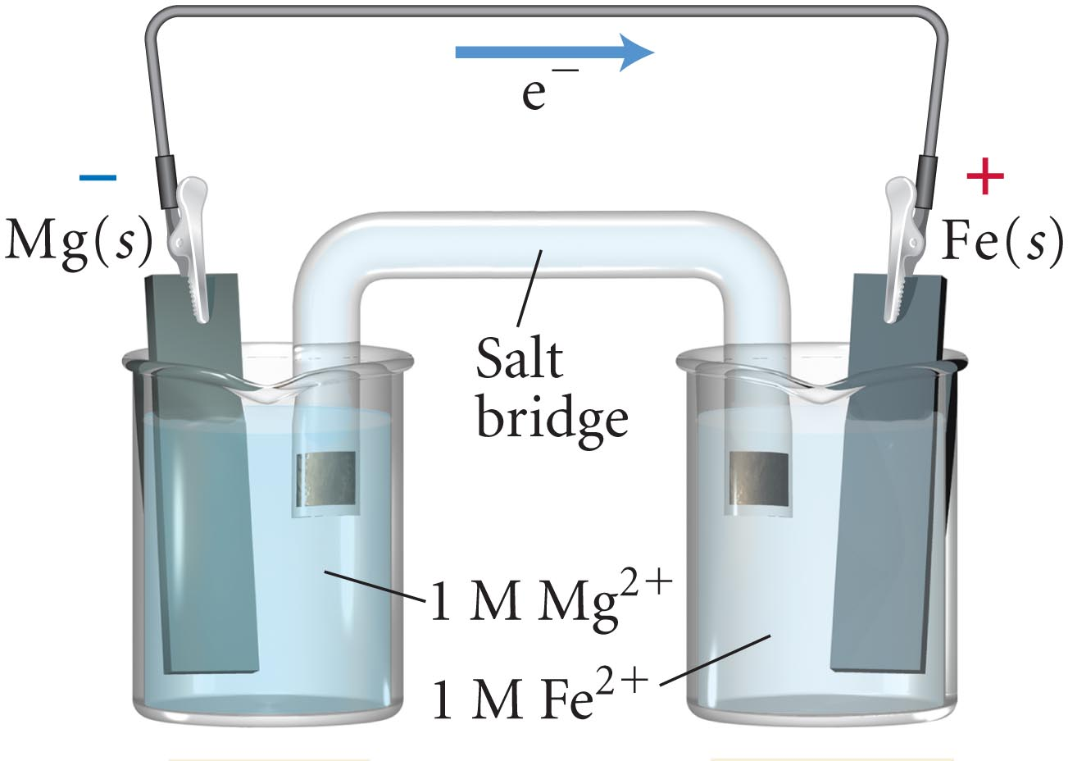
Nernst equation
Calculate the cell potential (E_{cell}) of an electrochemical cell at 298 K with Mg/Mg²⁺ and Fe/Fe²⁺ electrodes. [Mg²⁺] = 0.200 M and [Fe²⁺] = 0.050 M.
Fe²⁺ (aq) + 2 e– → Fe (s) E⁰ = –0.45V
Mg²⁺ (aq) + 2 e– → Mg (s) E⁰ = –2.37V

Slide 6
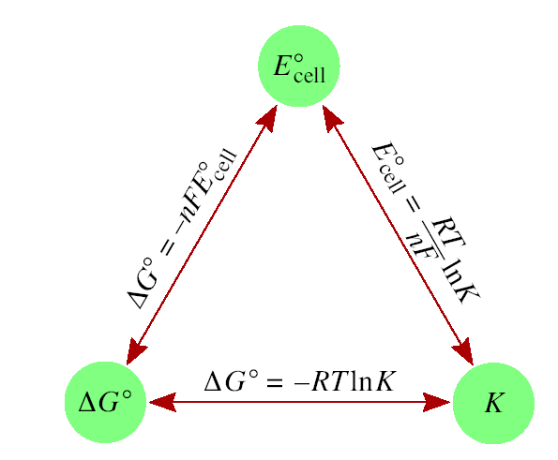
Nernst equation: Q, K, E, Eº, ΔG and ΔGº
RT
E_{cell} = Eº_{cell} -
ln Q
nF
In equilibrium E_{cell} = 0, Q = K
RT
Eº_{cell} = -
ln K
nF
Fill the following table assigning the criteria for spontaneity
 | ΔGº | Eº | K
Spontaneous
Non-Spontaneous

Slide 7
Nernst equation: Q, K, E, Eº, ΔG and ΔGº
Give the values for Q, K, E, Eº, ΔG and ΔGº in the following situations
Equilibrium. Dead battery
Reaction moving forward (as written)
Reaction moving backward (as written)

Slide 8
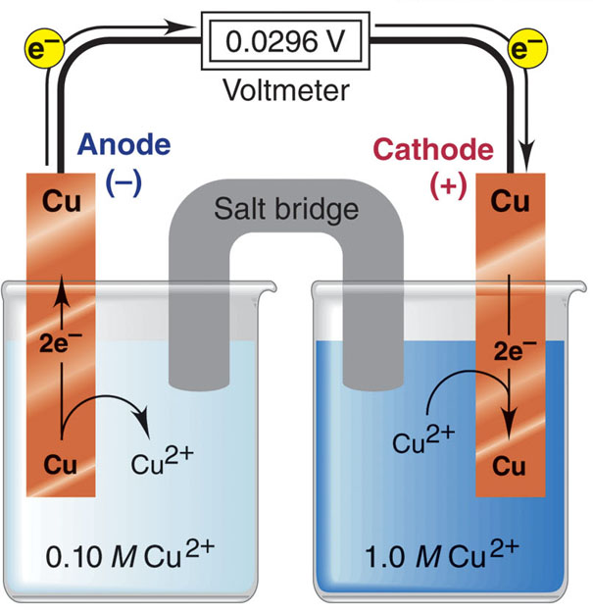
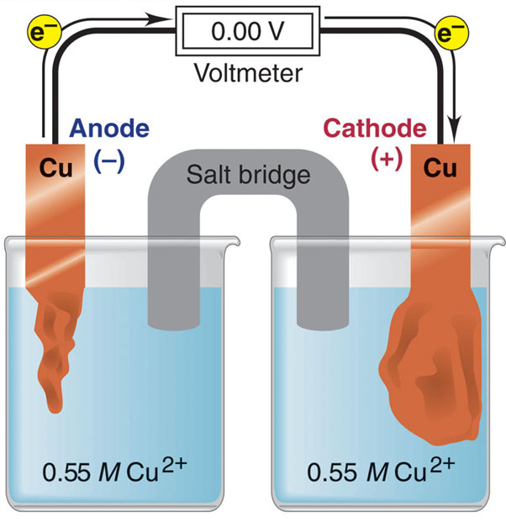
Concentration cells
You have two beakers. Both with CuCl₂. One [CuCl₂] = 0.1M and another at [CuCl₂] = 1.M. When we sink two copper electrodes we measure electric current. What reaction is happening on each of the beakers? When will it stop?

Slide 9
Concentration cells
Sample Problem 21.7:
Calculating the Potential of a Concentration Cell
PROBLEM:
A concentration cell consists of two Ag/Ag⁺ half-cells. In half-cell A, electrode A dips into 0.0100 M AgNO₃; in half-cell B, electrode B dips into 4.0x10⁻⁴ M AgNO₃. What is the cell potential at 298 K? Which electrode has a positive charge?

