Slide 1
Electrochemistry
General Chemistry II Chem2333

Slide 2
Outline
Module 5 – Session 6
Video 1: Electrolytic cells
The necessary potential to reverse a battery
Video 2: Electroplating
Faraday’s law
Video 3: Electrolysis (simple)
Electrolysis of molten salts
Video 4: Electrolysis. Different possible outcomes
Electrolysis of water

Slide 3
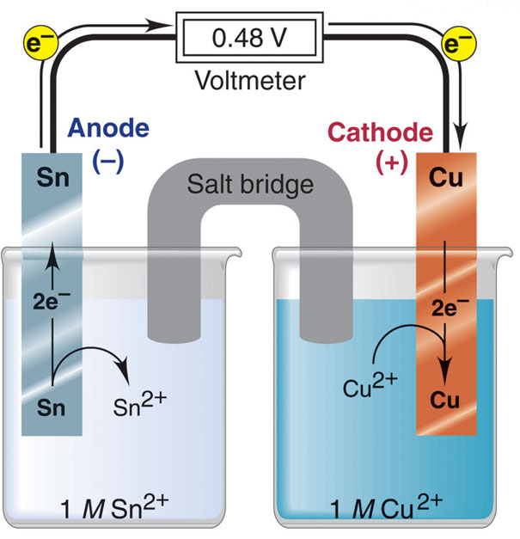
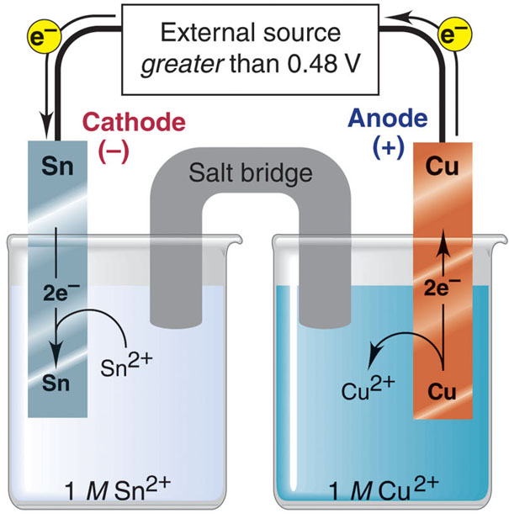
Electrolysis
voltaic cell
electrolytic cell
Oxidation half-reaction
Sn(s) Sn²⁺(aq) + 2e⁻
Oxidation half-reaction
Cu(s) Cu²⁺(aq) + 2e⁻
Reduction half-reaction
Cu²⁺(aq) + 2e⁻ Cu(s)
Reduction half-reaction
Sn²⁺(aq) + 2e⁻ Sn(s)
Overall (cell) reaction
Sn(s) + Cu²⁺(aq) Sn²⁺(aq) + Cu(s)
Overall (cell) reaction
Sn(s) + Cu²⁺(aq) Sn²⁺(aq) + Cu(s)

Slide 4
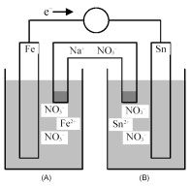
Electrolytic cell
If the cell in the picture is setup as a galvanic cell it has Eº = 0.3V.
write the overall reaction corresponding to an electrolyic cell. Identify the cathode and the anode in this case?
Does the label anode and cathode change in an electrolytic cell with respect to a galvanic/voltaic cell?
If there is 0.1M FeSO4 in the iron solution, and 0.1M SnCl2 in the tin solution. Calculate the electric potential. Calculate the necessary external electric potential to reverse the reaction.
If there is 0.2M of iron(II) chloride and 0.1M of tin chloride. Calculate the necessary external electric potential to reverse the reaction.

Slide 5
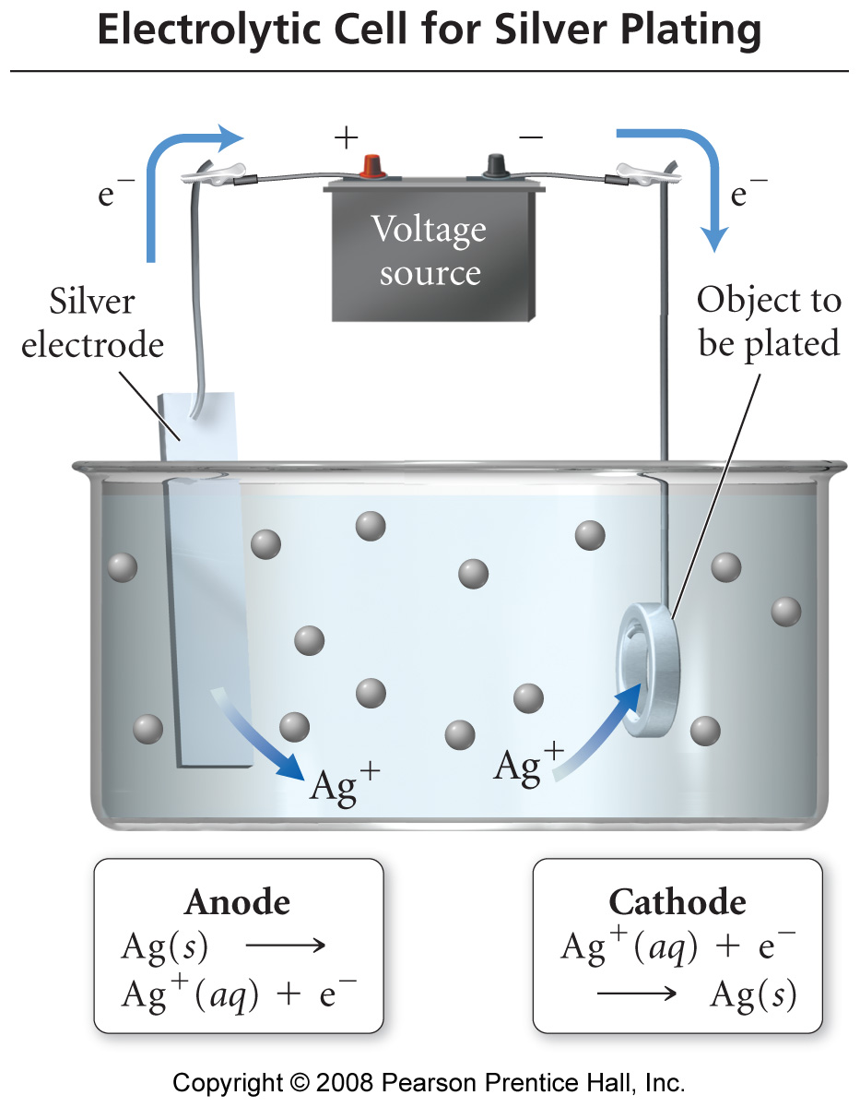
Electroplating metals
In electroplating, the work piece is the cathode.
Cations are reduced at cathode and plate to the surface of the work piece.
The anode is made of the plate metal. The anode oxidizes and replaces the metal cations in the solution

Slide 6
Electroplating metals
Faraday’s law
The amount of metal deposited during electrolysis is directly proportional to the charge on the cation, the current, and the length of time the cell runs
charge that flows through the cell = current x time The units of current are Amperes (A) = Coulomb/second (Charge/time)
2. Calculate the mass of silver that could be plated from a solution with a current of 3.3 A for 12 min.
Ag⁺(aq) + 1 electron → Ag(s)
3. Calculate the mass of copper that could be plated from a solution with a current of 1.2 A for 28 min.
Cu²⁺(aq) + 2 electron → Cu(s)

Slide 7
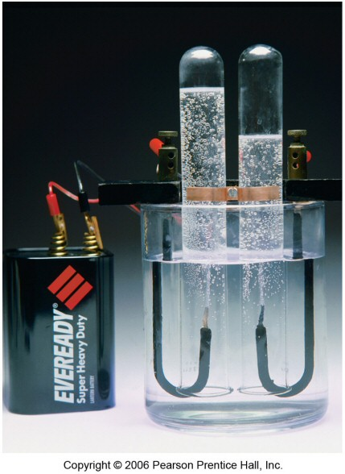
Electrolysis
electrolysis is the process of using electricity to break a compound apart
electrolytic cells can be used to separate elements from their compounds
generate H₂ from water for fuel cells
recover metals from their ores
Examples:
Na(s) + Cl₂(g) ← NaCl(aq)
2H_{2(g)} + O_{2(g)} ← 2H₂O(l)

Slide 8
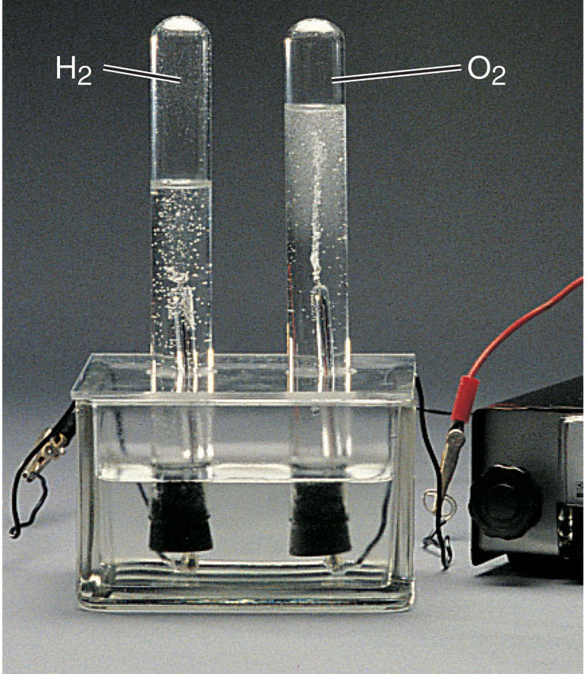
The electrolysis of water.
Why is there more volume of H₂ than O₂?
Overall (cell) reaction
2H₂O(l) H₂(g) + O₂(g)
Notice that these two reactions are the only two reactions possible. In water, hydrogen cannot oxidize and oxygen cannot reduce any further.
Oxidation half-reaction
2H₂O(l) 4H⁺(aq) + O₂(g) + 4e⁻
Reduction half-reaction
2H₂O(l) + 4e⁻ 2H₂(g) + 2OH⁻(aq)
Spring 2012
Chem 2333: General Chemistry II
8

Slide 9
The electrolysis of water.
Oxidation half-reaction
2H₂O(l) 4H⁺(aq) + O₂(g) + 4e⁻
Eº =-1.29V
Water has a pH=7, so [H⁺] is not 1M
But 1E-7M. Using Nernst Equation →
E =-0.82V
Reduction half-reaction
2H₂O(l) + 4e⁻ 2H₂(g) + 2OH⁻(aq)
Eº =-0.82V
Water has a pH=7, so [OH⁻] is not 1M
But 1E-7M. Using Nernst Equation →
E =-0.42V
2H₂O(l) → 4H⁺(aq) + O₂(g) + 4e⁻
E =-0.82V + overpotential = [-1.22,-1.42V]
2H₂O(l) + 4e⁻ → 2H₂(g) + 2OH⁻(aq)
E =-0.42V + overpotential = [-0.82,-1.02]
→Overvoltage (life is not so simple): additional 0.4-0.6V
Usually an overvoltage is needed due to kinetic factors. The formation of gas on the solid electrode has a higher energy barrier.

Slide 10
Electrolysis of mixture of ions
What will be the products of the electrolysis of an aqueous solution of silver fluoride (AgF)?
2H₂O(l) → 4H⁺(aq) + O₂(g) + 4e⁻
E =-0.82V + overpotential = [-1.22,-1.42V]
2H₂O(l) + 4e⁻ → 2H₂(g) + 2OH⁻(aq)
E =-0.42V + overpotential = [-0.82,-1.02]
F⁻ + 1e⁻ → doesn’t accept more e-
Ag⁺ +1e⁻ → Ag
E=+0.799V
2F⁻ → F₂ +2e⁻
E= -2.87V
Ag⁺ → can’t remove more e⁻
Reaction in the cathode:
What species is easier to reduce?
Reaction in the anode:
What species is easier to oxidize?
Remember we are looking for the combination with the most positive E

Slide 11
Electrolysis of mixture of ions
Sample Problem 21.9:
Predicting the Electrolysis Products of Aqueous Ionic Solutions
PROBLEM:
What products form during electrolysis of aqueous solution of the following salts: (a) KBr; (b) AgNO₃; (c) MgSO₄?
(a) K⁺(aq) + e⁻ K(s)
Eº = -2.93 V
2H₂O(l) + 2e⁻ H₂(g) + 2OH⁻(aq)
Eº = -0.42 V
2Br⁻(aq) Br₂(g) + 2e⁻
Eº = 1.07 V
2H₂O(l) O₂(g) + 4H⁺(aq) + 4e⁻
Eº = 0.82 V
(b) Ag⁺(aq) + e⁻ Ag(s)
Eº = -0.80 V
(c) Mg²⁺(aq) + 2e⁻ Mg(s)
Eº = -2.37 V

Slide 12
Electrodeposition
→An antique automobile bumper is to be chrome plated. The bumper, which is dipped into an acidic Cr₂O⁷₂– solution, serves as a cathode of an electrolytic cell. The atomic mass of Cr is 51.996; 1 faraday = 96,485 coulombs/mol e⁻.
If the current is 15.0 amperes, how long will it take to deposit 1.32 × 10² g of Cr(s) onto the bumper?

