Slide 1
Electrochemistry
General Chemistry II Chem2333

Slide 2
Outline
Module 5 – Session 6
Video 1: Electrolytic cells
The necessary potential to reverse a battery
Video 2: Electroplating
Faraday’s law
Video 3: Electrolysis of pure compounds
Electrolysis of molten salts
Video 4: Electrolysis. Different possible outcomes
Electrolysis of water. Overpotential

Slide 3
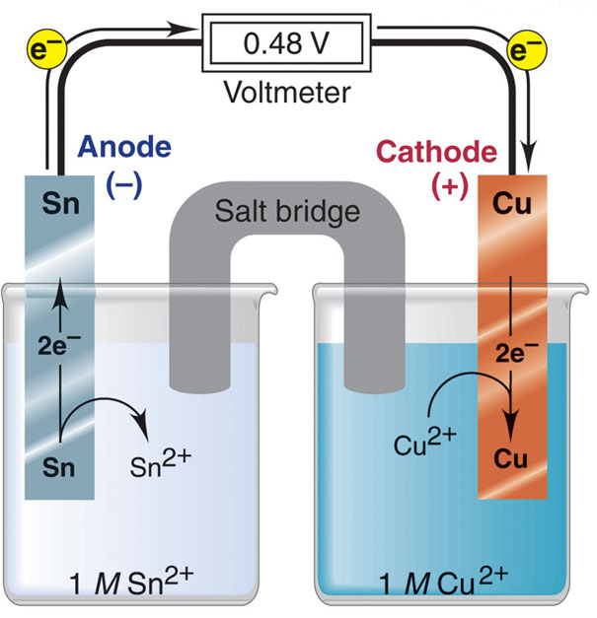
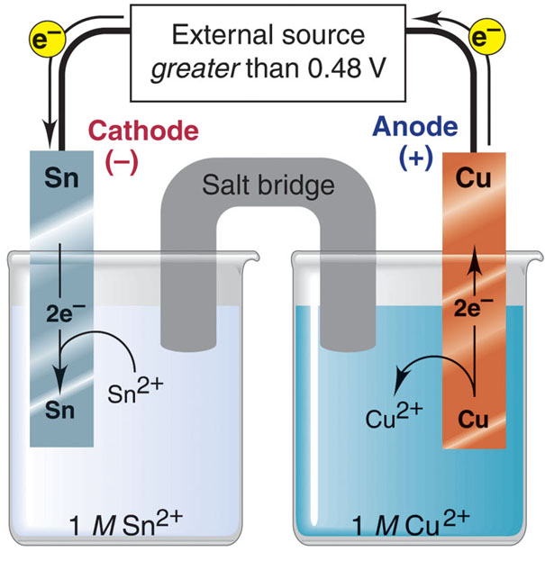
Electrolysis
voltaic cell
electrolytic cell
Oxidation half-reaction
Sn(s) Sn²⁺(aq) + 2e⁻
Oxidation half-reaction
Cu(s) Cu²⁺(aq) + 2e⁻
Reduction half-reaction
Cu²⁺(aq) + 2e⁻ Cu(s)
Reduction half-reaction
Sn²⁺(aq) + 2e⁻ Sn(s)
Overall (cell) reaction
Sn(s) + Cu²⁺(aq) Sn²⁺(aq) + Cu(s)
Overall (cell) reaction
Sn(s) + Cu²⁺(aq) Sn²⁺(aq) + Cu(s)

Slide 4
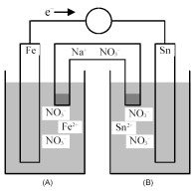
Electrolytic cell
The galvanic cell below has Eº = 0.3V
→How much external potential do you need to apply to reverse the direction of electrons when there is 1M of iron(II) nitrate and tin (II) nitrate?
→What changes (thinning or growing) you will see in the electrodes when the reaction is reversed?
→We let the spontaneous reaction (galvanic or voltaic cell) react until the potential indicated by the voltmeter is zero:
→how much voltage do we need to apply to reverse the reaction?
→how much voltage do we need to apply to continue with the reaction

Slide 5
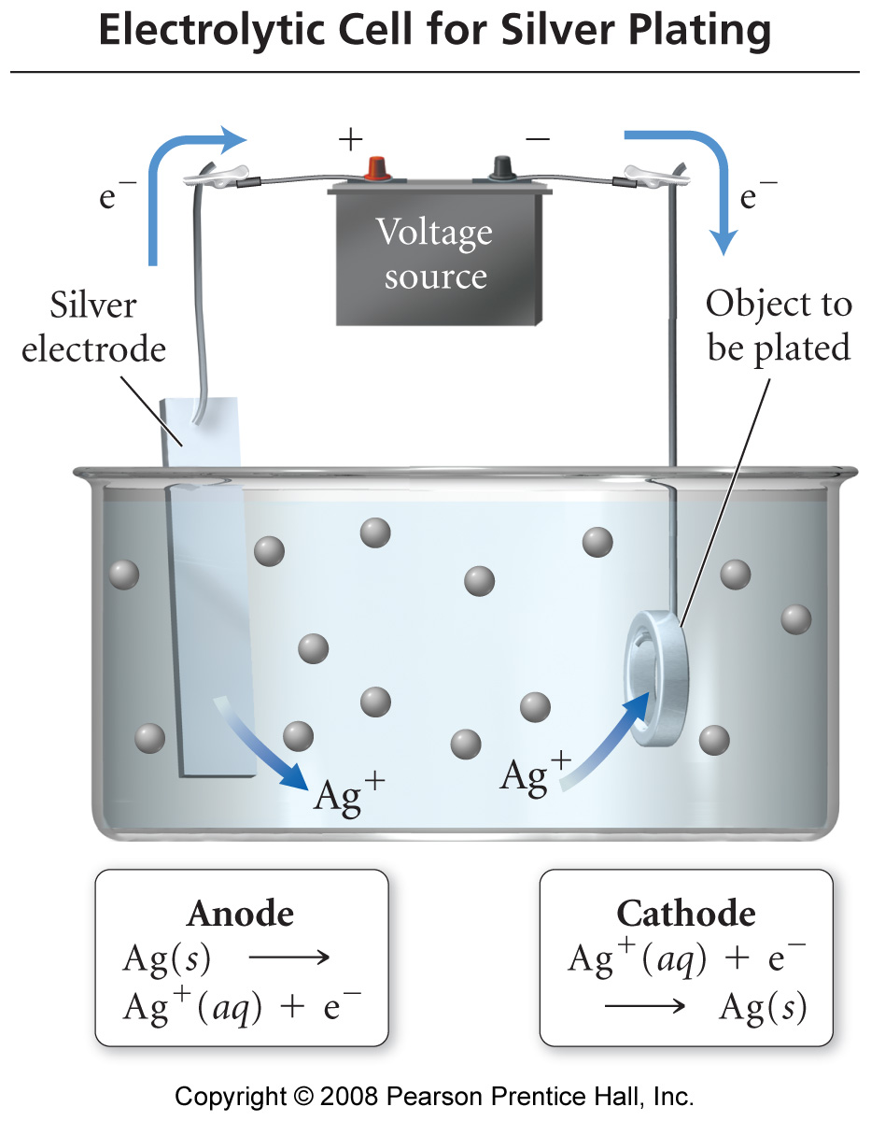
Electroplating metals
In electroplating, the work piece is the cathode.
Cations are reduced at cathode and plate to the surface of the work piece.
The anode is made of the plate metal. The anode oxidizes and replaces the metal cations in the solution

Slide 6
Electroplating metals
Faraday’s law
The amount of metal deposited during electrolysis is directly proportional to the charge on the cation, the current, and the length of time the cell runs
charge that flows through the cell = current x time The units of current are Amperes (A) = Coulomb/second (Charge/time)
1. Calculate the mass of gold that could be plated from a solution with a current of 0.40 A for 22 min.
Au³⁺(aq) + 3 electrons → Au(s)

Slide 7
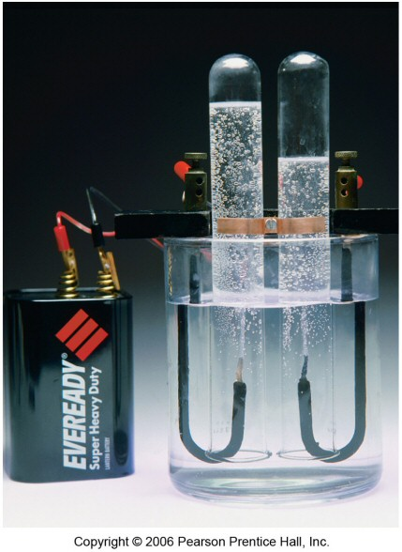
Electrolysis
electrolysis is the process of using electricity to break a compound apart
electrolytic cells can be used to separate elements from their compounds
generate H₂ from water for fuel cells
recover metals from their ores
Examples:
Na(l) + ½ Cl₂(g) ← NaCl(l)
2H_{2(g)} + O_{2(g)} ← 2H₂O(l)

Slide 8
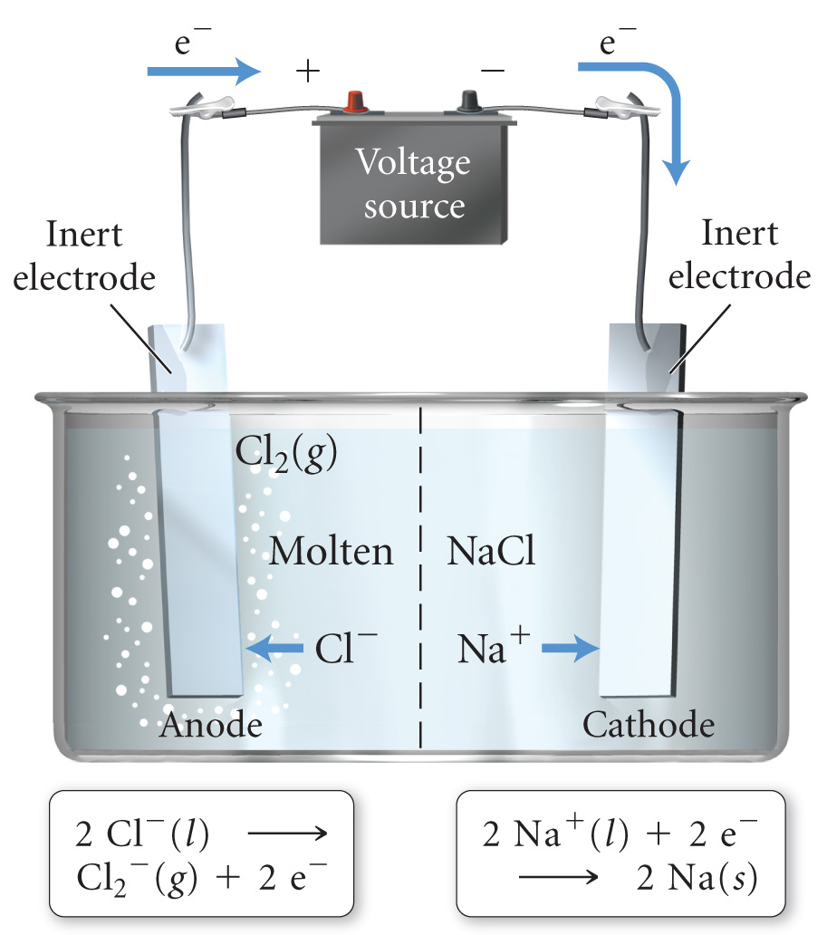
Electrolysis of pure compounds
→Electrolysis of a molten salt with the formula MCl, using a current of 3.86 amp for 16.2 min, deposits 1.52 g of metal. Identify the metal. (1 faraday = 96,485 coulombs)

Slide 9
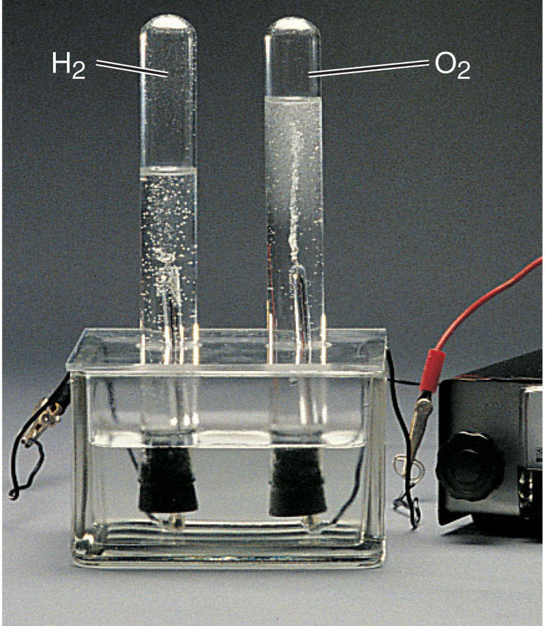
The electrolysis of water.
Why is there more volume of H₂ than O₂?
Overall (cell) reaction
2H₂O(l) H₂(g) + ½ O₂(g)
Notice that these two reactions are the only two reactions possible. In water, hydrogen cannot oxidize and oxygen cannot reduce any further.
Oxidation half-reaction
2H₂O(l) 4H⁺(aq) + O₂(g) + 4e⁻
Reduction half-reaction
2H₂O(l) + 4e⁻ 2H₂(g) + 2OH⁻(aq)
Spring 2012
Chem 2333: General Chemistry II
9

Slide 10
The electrolysis of water.
Oxidation half-reaction
2H₂O(l) 4H⁺(aq) + O₂(g) + 4e⁻
Eº =-1.29V
Water has a pH=7, so [H⁺] is not 1M
But 1E-7M. Using Nernst Equation →
E =-0.82V
Reduction half-reaction
2H₂O(l) + 4e⁻ 2H₂(g) + 2OH⁻(aq)
Eº =-0.82V
Water has a pH=7, so [OH⁻] is not 1M
But 1E-7M. Using Nernst Equation →
E =-0.42V
2H₂O(l) → 4H⁺(aq) + O₂(g) + 4e⁻
E =-0.82V + overpotential = [-1.22,-1.42V]
2H₂O(l) + 4e⁻ → 2H₂(g) + 2OH⁻(aq)
E =-0.42V + overpotential = [-0.82,-1.02]
→Overvoltage: additional 0.4-0.6V
Usually an overvoltage is needed due to kinetic factors. The formation of gas on the solid electrode has a higher energy barrier.

Slide 11
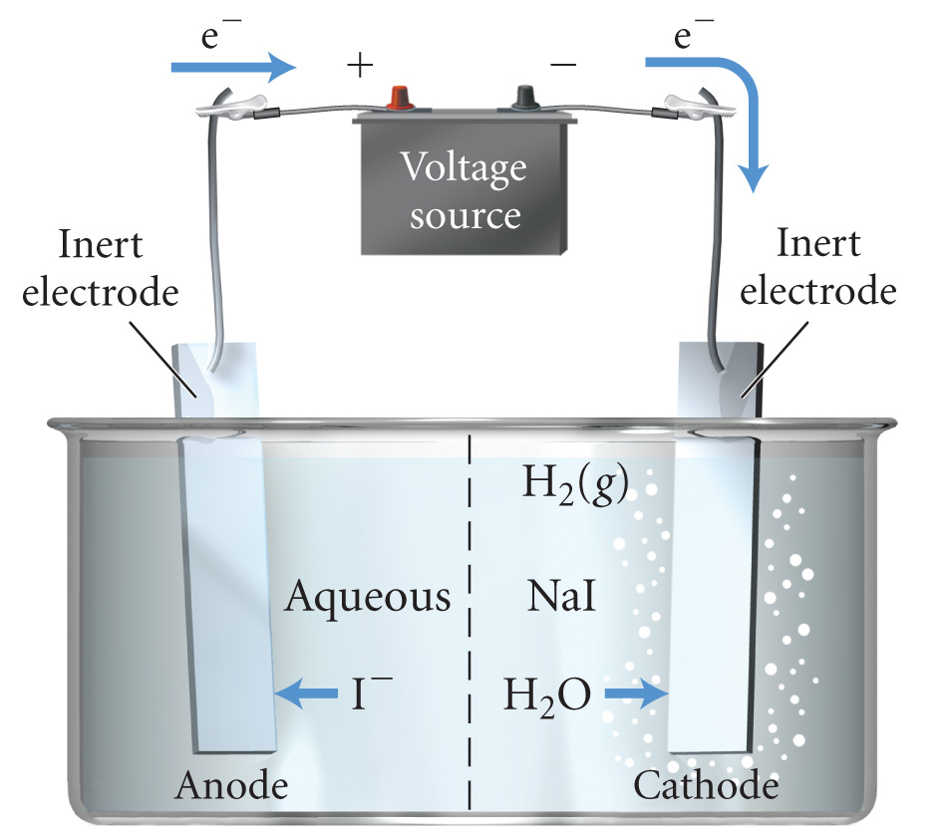
Electrolysis of mixture of ions
possible oxidations
2 I⁻¹ → I₂ + 2 e⁻¹
2 H₂O → O₂ + 4e⁻¹ + 4H⁺¹
E° = −0.54 v
E° = −0.82 v
possible reductions
Na⁺¹ + 1e⁻¹ → Na⁰
2 H₂O + 2 e⁻¹ → H₂ + 2 OH⁻¹
E° = −2.71 v
E° = −0.41 v
overall reaction
2 I⁻_{(aq)} + 2 H₂O_{(l)} → I_{2(aq)} + H_{2(g)} + 2 OH⁻¹_{(aq)}
→When more than one cation is present, the cation that is easiest to reduce will be reduced first at the cathode: least negative or most positive E°_{red}
→When more than one anion is present, the anion that is easiest to oxidize will be oxidized first at the anode : least negative or most positive E°_{ox}

Slide 12
Electrolysis of mixture of ions
Sample Problem 21.8:
Predicting the Electrolysis Products of a Molten Salt Mixture
PROBLEM:
A chemical engineer melts a naturally occurring mixture of NaBr and MgCl₂ and decomposes it in an electrolytic cell. Predict the substance formed at each electrode, and write balanced half-reactions and the overall cell reaction without looking at any table with reduction potentials.

