Slide 1
Transition Metals: Structure and Bonding
General Chemistry II Chem2333

Slide 2
Transition Metals
Module 6 – Session 2
Video 1: Introduction to coordination compounds
Video 2: Components of coordination compounds
Video 3: Ligands and coordination number
Video 4: Geometry and isomerism

Slide 3
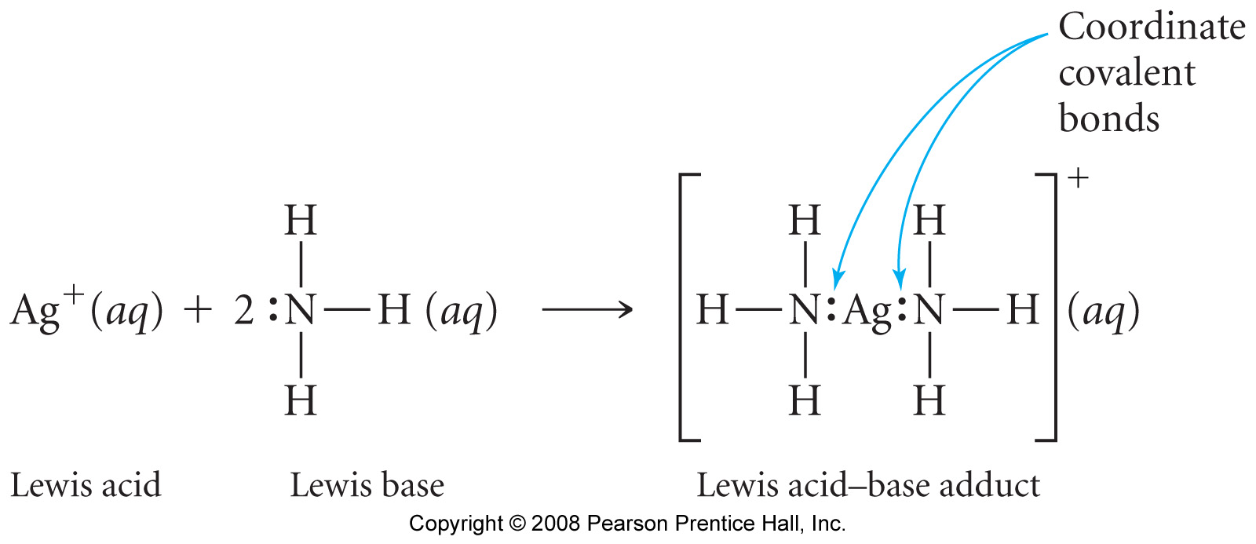
Coordination Compounds: An Acid-Base Reaction
Properties of transition metals include:
Incompletely filled d subshells (Lewis Acids)
Will react with ligands (Lewis Bases)
[Ag(NH₃)₂]⁺
It’s a new molecule, not an ionic bond.
Metal complex (or coordination compounds) formation is a type of Lewis acid-base reaction.
Ag⁺ cannot be considered a point charge cation like Na⁺.
Therefore the bond is not completely ionic.

Slide 4
Introduction to coordination compounds
A: [Co(NH₃)₅Cl]²⁺
B: [Au(OH)₄]⁽⁻⁾
C: [Cr(NH₃)₆]⁽³⁺⁾
D: [CuCl₂]⁽⁻⁾
E: [V(CN)₆]⁽⁴⁻⁾
F: [Cr(NH₃)₄Cl₂]⁽⁺⁾
G: [Ag(NH₃) ₂]⁽⁻⁾
H: Fe(CO)₅
Which of the following statements is true about coordination complexes?
The metal is a Lewis base and the ligands are Lewis acids.
Only complexes with coordination number 6 are found in nature.
There are coordination complexes with Na⁺ and Mg²⁺ as metals.
Metal complexes are always neutral
Fe₂O₃, MnO₄⁽⁻⁾, MgCl₂, AlCl₃ are all coordination compounds.

Slide 5
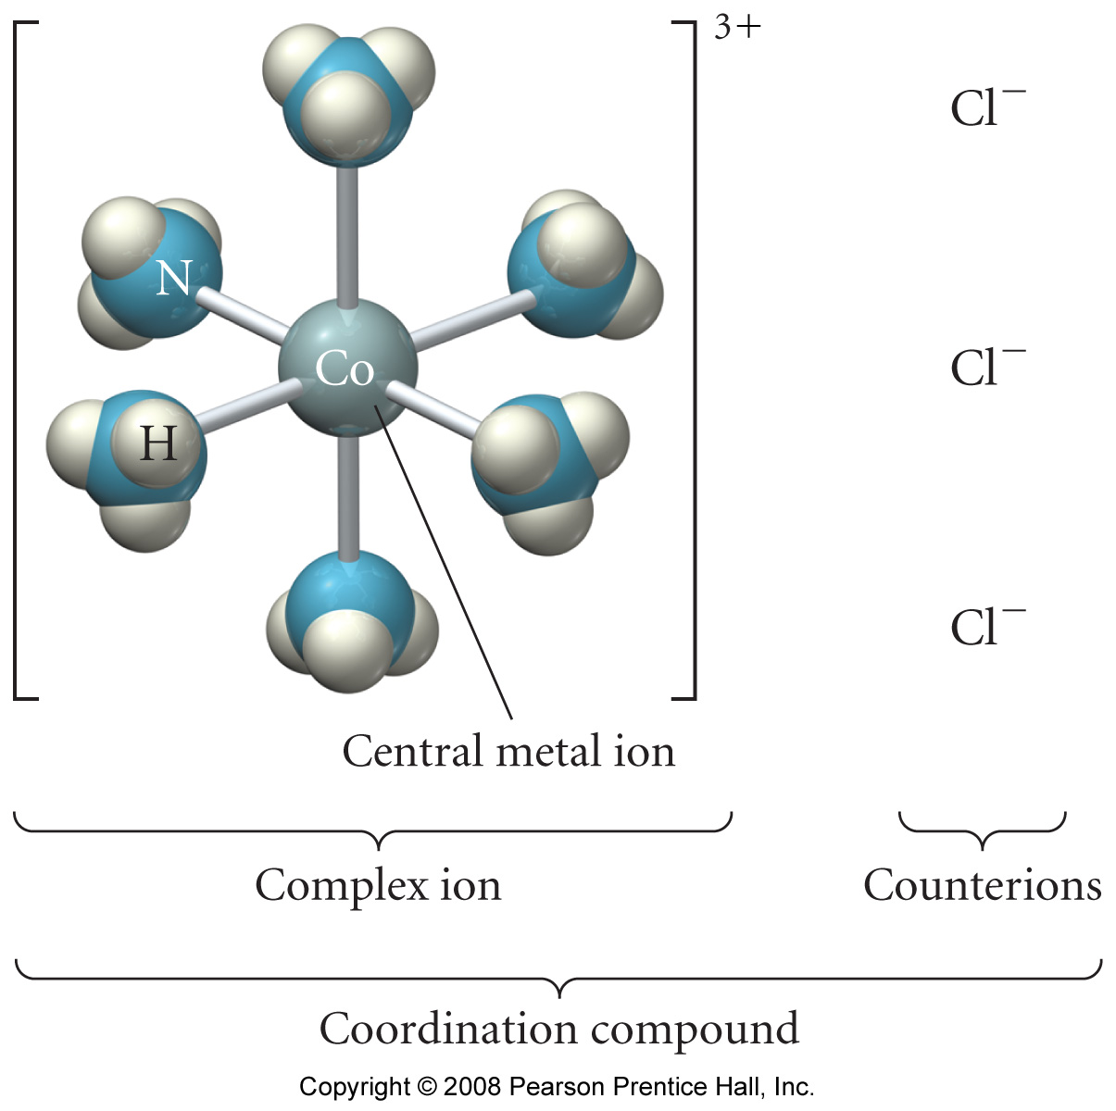
Coordination Compounds: Components
Ionic
Coordination number - the number of ligand atoms that are bonded directly to the central metal ion. The coordination number is specific for a given metal ion in a particular oxidation state and compound.
[Co(NH₃)₆]Cl₃
Covalent
Ionic
Bond
Ligands
A ligand has at least one unshared pair of valence electrons
•
•
•
•
•
•
N
O
H
H
H
H
H
•
•
-
Cl
•
•
•
•
•
•
C
O
•
•
•
•

Slide 6
Coordination Compounds: Components
For each of the following compounds Identify
the ligands
the counterions
possible ions in water
the central atom
the coordination number
the oxidation state of the metal
[Co(NH₃)₅Cl]Cl₂
[Cr(NH₃)₆](NO₃)₃
Na₄[V(CN)₆]
[Cr(NH₃)₄Cl₂]₃PO₄
[Ag(NH₃) ₂]₂SO₄
Fe(CO)₅

Slide 7
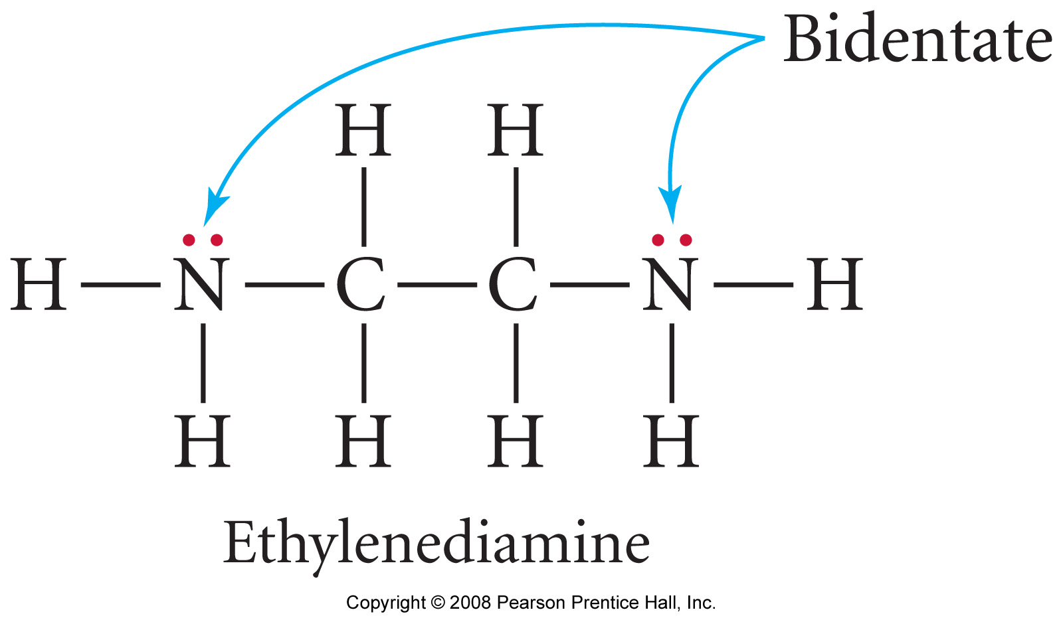
Ligands and coordination number
The atom in a ligand that is bound directly to the metal atom is the donor atom.
•
•
•
•
•
•
O
N
H
H
H
H
H
The number of donor atoms surrounding the central metal atom in a complex ion is the coordination number.
# Donors | Teeth | Examples
One donor atom | Monodentate | H₂O, NH₃, Cl⁻, CO
Two donor atoms | Bidentate | Ethylenediamine (en), Oxalate
Three or more | Polydentate | EDTA
→ Some ligands can form more than one coordinate covalent bond with the metal atom lone pairs on different atoms that are separate enough so that both can reach the metal
7

Slide 8
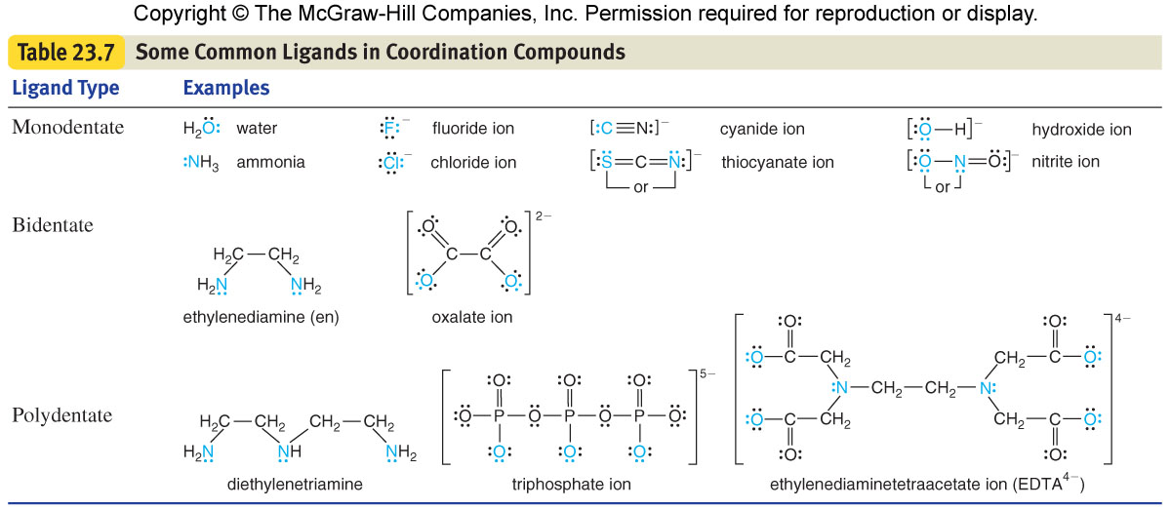
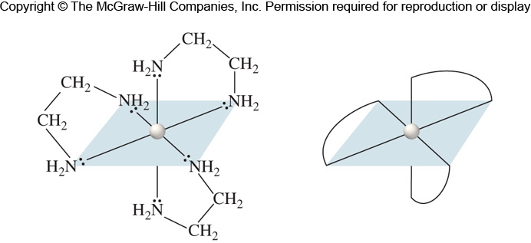
Ligands and coordination number
Chelate is a complex ion containing a multidentate ligand
The ligand is called the chelating agent
What’s the coordination #?

Slide 9
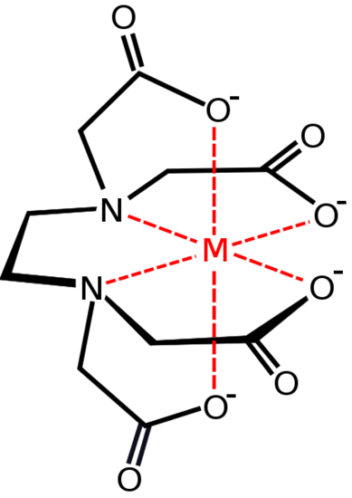
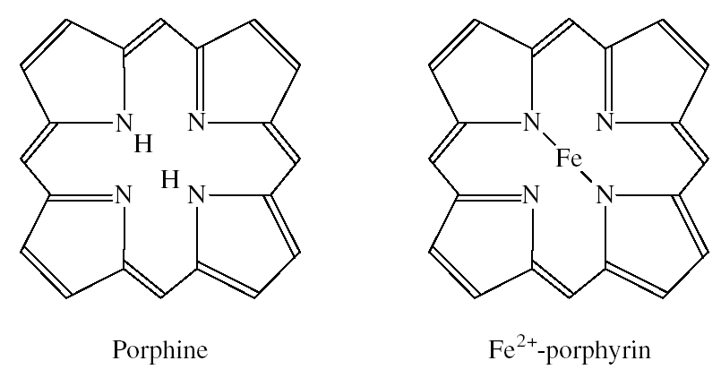
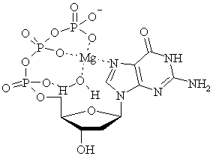
Ligands and coordination number
EDTA chelating agent
Triphosphate is a tri-dentate chelating agent

Slide 10
Ligands and coordination number
What is the coordination number and the charge of the metal of the following complexes
[Cr(en)₃]Cl₃
[Ni(en)(NH₃)₂][NO₃]₂
[K₃[Cr(C₂O₄)₃].3H₂O
[Fe(EDTA)]⁻

Slide 11
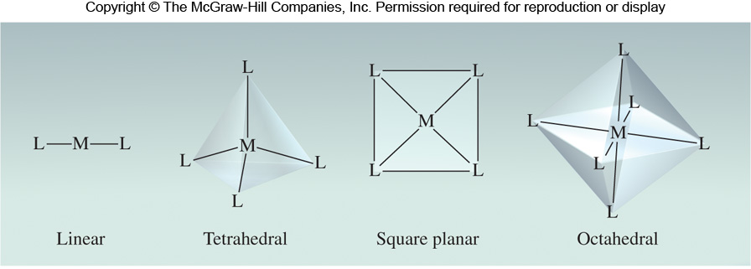
Coordination Compounds: Geometry
The geometry (shape) of a complex ion depends on the coordination number and nature of the metal ion, and it plays a significant role in determining its properties. We will be able to explain why some metals give some geometries.
Coordination Number | Structure
2 | Linear
4 | Tetrahedral or square planar
6 | Octahedral
→Explore the different shapes. Find examples of the four main geometries
http://www.stolaf.edu/depts/chemistry/mo/struc/explore.htm

Slide 12
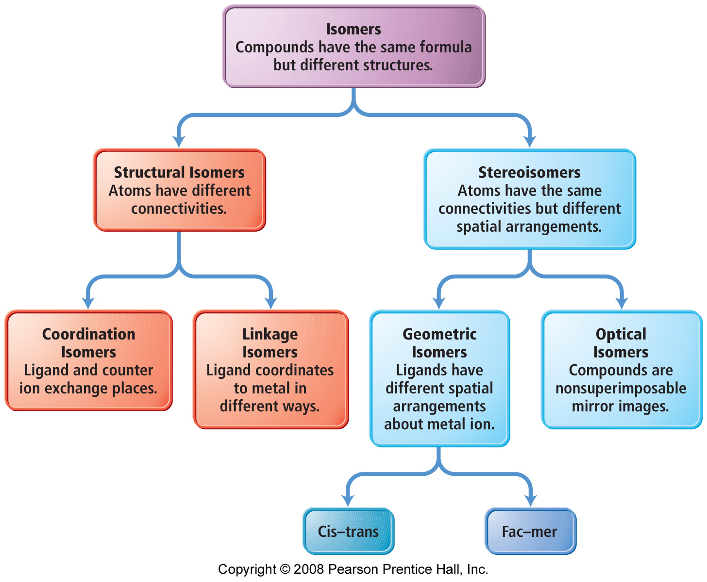
Isomerism
Case 1
Case 2
Case 4
Case 3

Slide 13
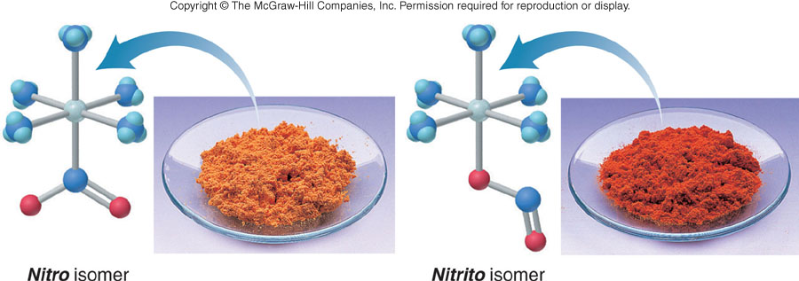
Isomerism
ISOMERS
Same chemical formula, but different properties
Case 1: [Cr(NH₃)₅(SO₄)]Br and [Cr(NH₃)₅Br]SO₄
Coordination
Case 2:
Linkage
Case 3:
Geometry

Slide 14
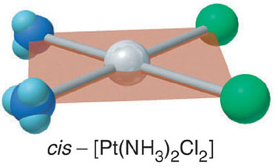
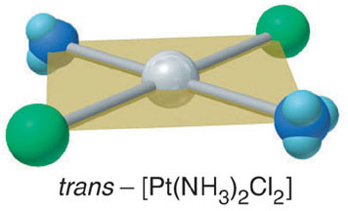
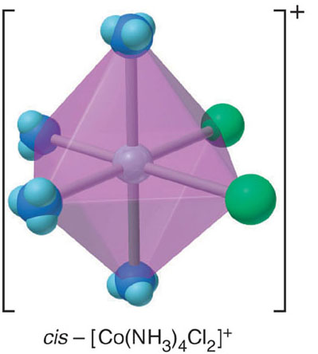
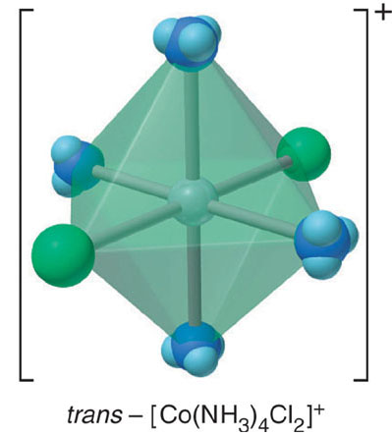
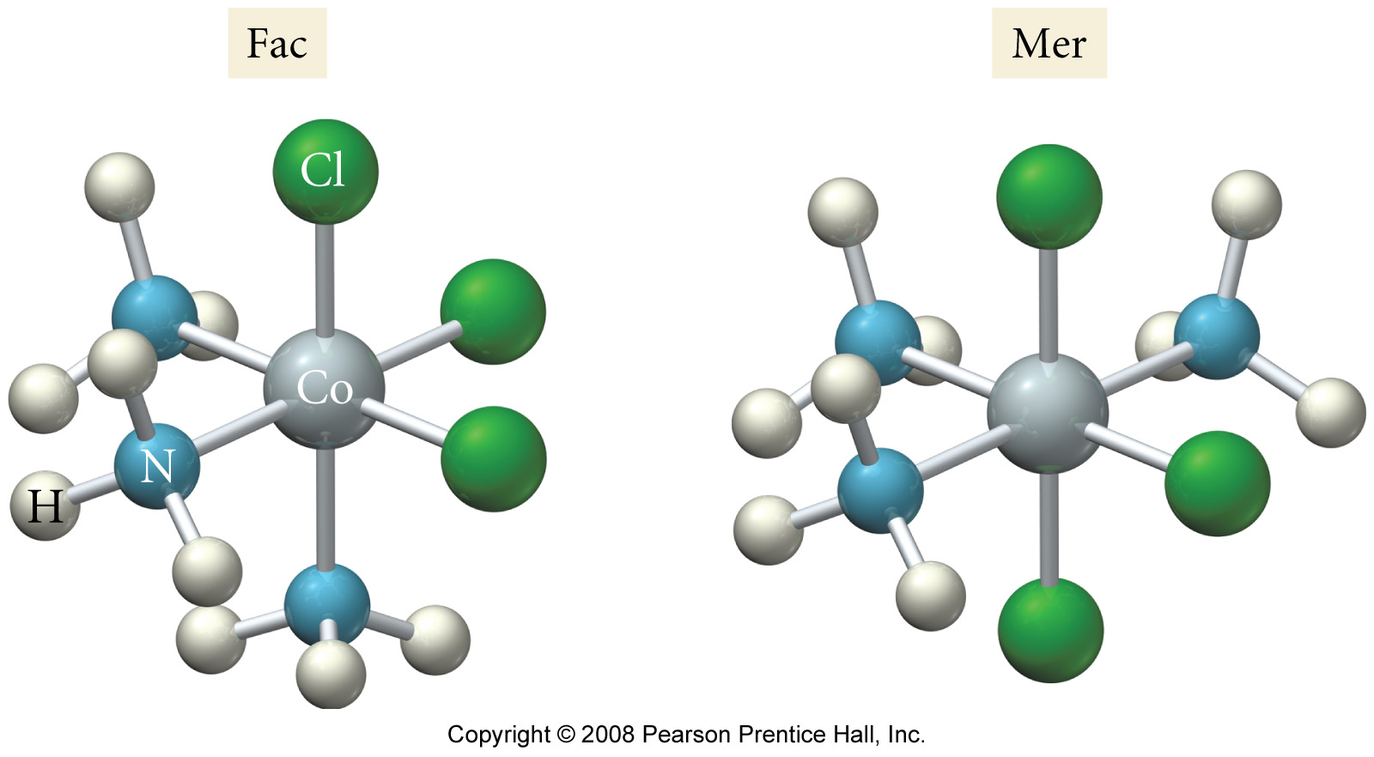
Geometric (cis-trans) / (fac-mer) isomerism.
Figure 23.11

Slide 15
Geometric (cis-trans) / (fac-mer) isomerism.
Trans:
http://www.stolaf.edu/depts/chemistry/mo/struc/explore.htm?list=tCoen2Cl2&view=1
Cis:
http://www.stolaf.edu/depts/chemistry/mo/struc/explore.htm?list=cCoen2Cl2&view=1
Fac:
http://www.stolaf.edu/depts/chemistry/mo/struc/explore.htm?list=fTiAnCl3&view=1
Mer:
http://www.stolaf.edu/depts/chemistry/mo/struc/explore.htm?list=mTiAnCl3&view=1

Slide 16
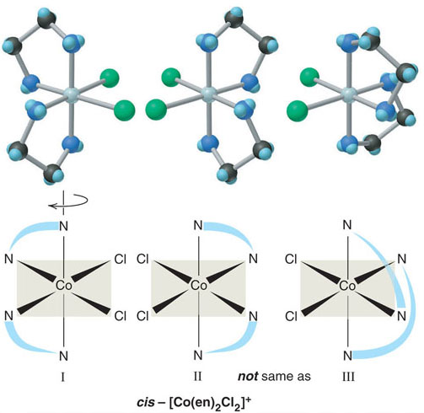
Coordination Compounds: Optical Isomerism
Case 4:
Click here: http://chem.r.umn.edu/chem2333/optical_isomerism/ Are they the same?
Are these Coordination Compounds different?
Optical isomerism

Slide 17
Isomerism
What is the relationship between the following two square planar complex ions?
The complex ions are:
1. linkage isomers
2. coordination isomers
3. geometric isomers
4. optical isomers
5. the same

