Slide 1
Transition Metals: Structure and Bonding
General Chemistry II Chem2333

Slide 2
Transition Metals
Module 6 – Session 3
Video 1: Reviewing theories of bonding.
We need a better description of bonding
Video 2: Lewis structures (videos from first semesters)
Video 3: Combining atomic orbitals. Hybrid orbitals (I).
Why hybrid orbitals and not just orbitals?
sp hybridization
Video 4: Hybrid orbitals (II)

Slide 3
The need for a better bonding theory
There are some observations that we cannot explain with current theories of bonding.
NiCO₄ is tetrahedral
Pt(CO)₄ is square-planar
Co admits six ligands but Ni only four.
[Co(NH₃)₆]³⁺ is yellow and [Co(NH₃)₅Cl]²⁺ is purple
[FeBr₆]⁴⁻ is paramagnetic (unparied electrons) and [Fe(CN)₆]⁴⁻ is diamagnetic (paired e)

Slide 4
Theories of bonding
The main successes of each theory
Theory | Distinguish between cases
Lewis structures | N₂ bond is stronger | F₂ is weaker
VSEPR theory | BF₃ is non-polar | NH₃ has a dipole
Valence Bond Theory | 1,2-dichloroethane rotates around C-C | There are two E and Z 1,2-dichlorethene. C-C doesn’t rotate
Molecular orbital theory | N₂ is not attracted by magnets | O₂ is attracted by magnets

Slide 5
Theories of bonding
→For each of these questions you first need to know what theory will give you the answer
Which of the following compounds has the shortest bond between nitrogen and oxygen?
a. NO₃⁻ b. N₂O c. NOCl d. H₃NO
Which of the following formulas represent substances that are likely to be stable at ordinary temperature and pressure?
a. BF₅ b. BrF₅ c. NCl₃ d. OF₂ e. SF₄
Which of the following has the smallest H-X-H bond angle?
a. PH₃ b. NH₄⁺ c. C₂H₄ d. H₂S
Which of the following molecules is nonpolar?
a. BrF₃ b. NF₃ c. BF₃ d. OF₂
Which of the following molecules has the longest bond?
a. O₂ b. O₂⁺ c. O₂⁻ d. O₂²⁻

Slide 6
Theories of bonding
Different theories for the same problem.
One is not necessarily better than the other.
They will answer different questions or may have different disadvantages or pitfalls
Theory | Predict molecular charge | Predict molecular structure | Predict molecular dipole | Predict rotation of bonds | Displays an accurate bonding pattern | Predicts bond energies | Predicts magnetism of molecules | Easy to visualize and little math
Lewis Structures | ✔ |  |  |  |  |  |  | ✔
VSEPR | ✔ | ✔ | ✔ |  |  |  |  | ✔
Valence Bond Theory | ✔ | ✔ | ✔ | ✔ |  | ✔ |  | ✔
Molecular Orbital Theory | ✔ | ✔ | ✔ | ✔ | ✔ | ✔ | ✔

Slide 7
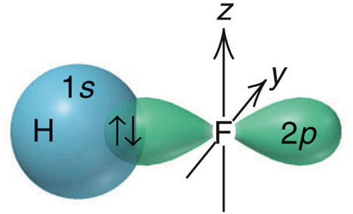
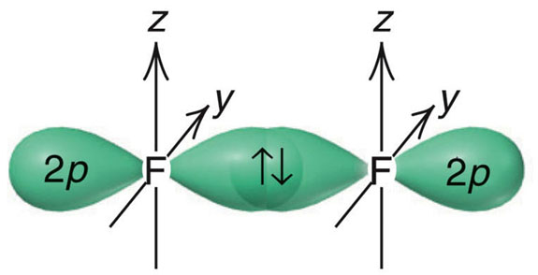
Valence Bond Theory: Themes
Hydrogen, H₂
1. A set of overlapping orbitals has a maximum of two electrons that must have opposite spins.
Hydrogen fluoride, HF
2. The greater the orbital overlap, the stronger (more stable) the bond. HF > HCl
3. The valence atomic orbitals in a molecule are different from those in isolated atoms.
4. There is a hybridization of atomic orbitals to form the molecule.
Fluorine, F₂

Slide 8
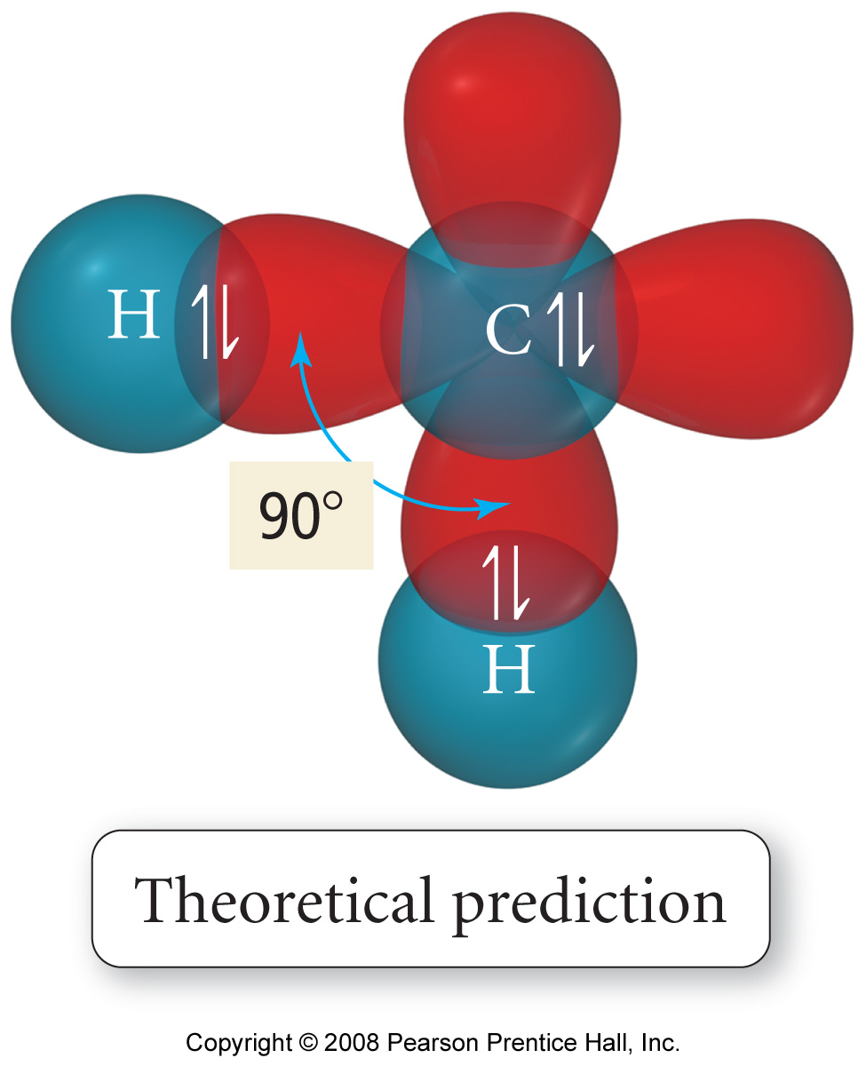
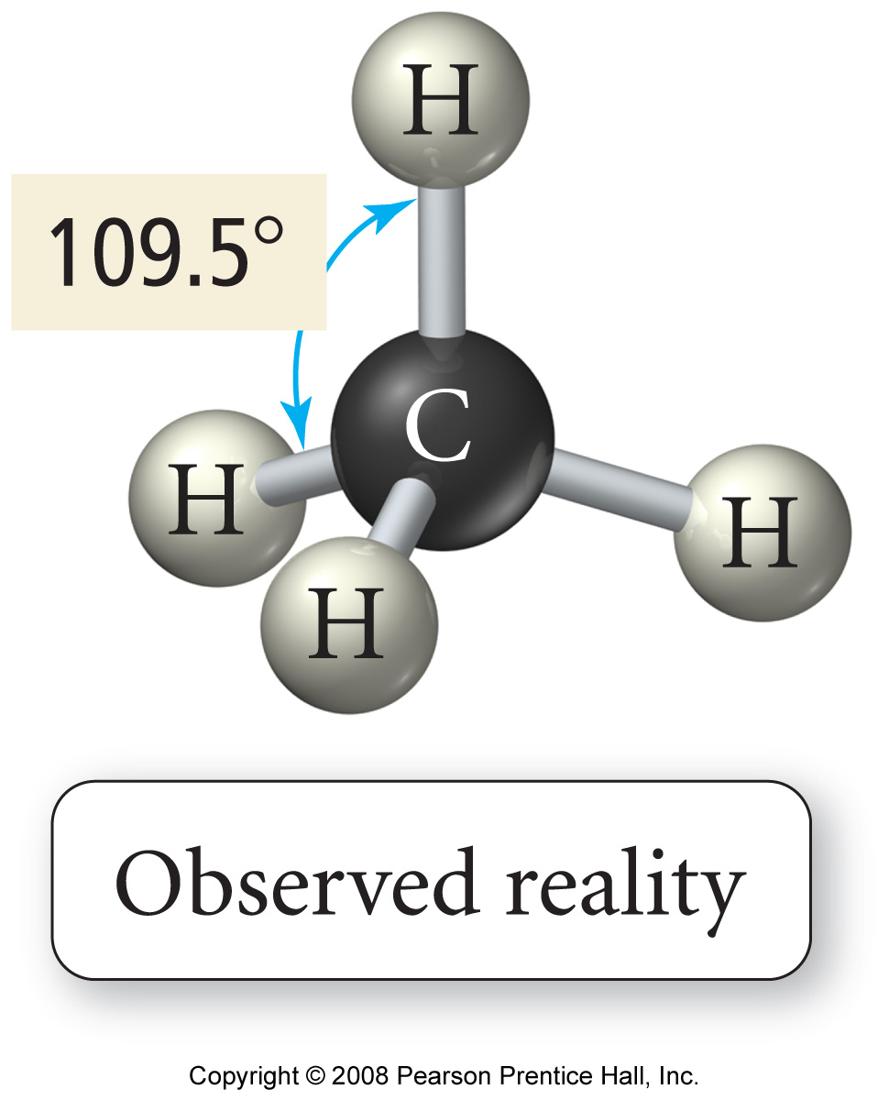
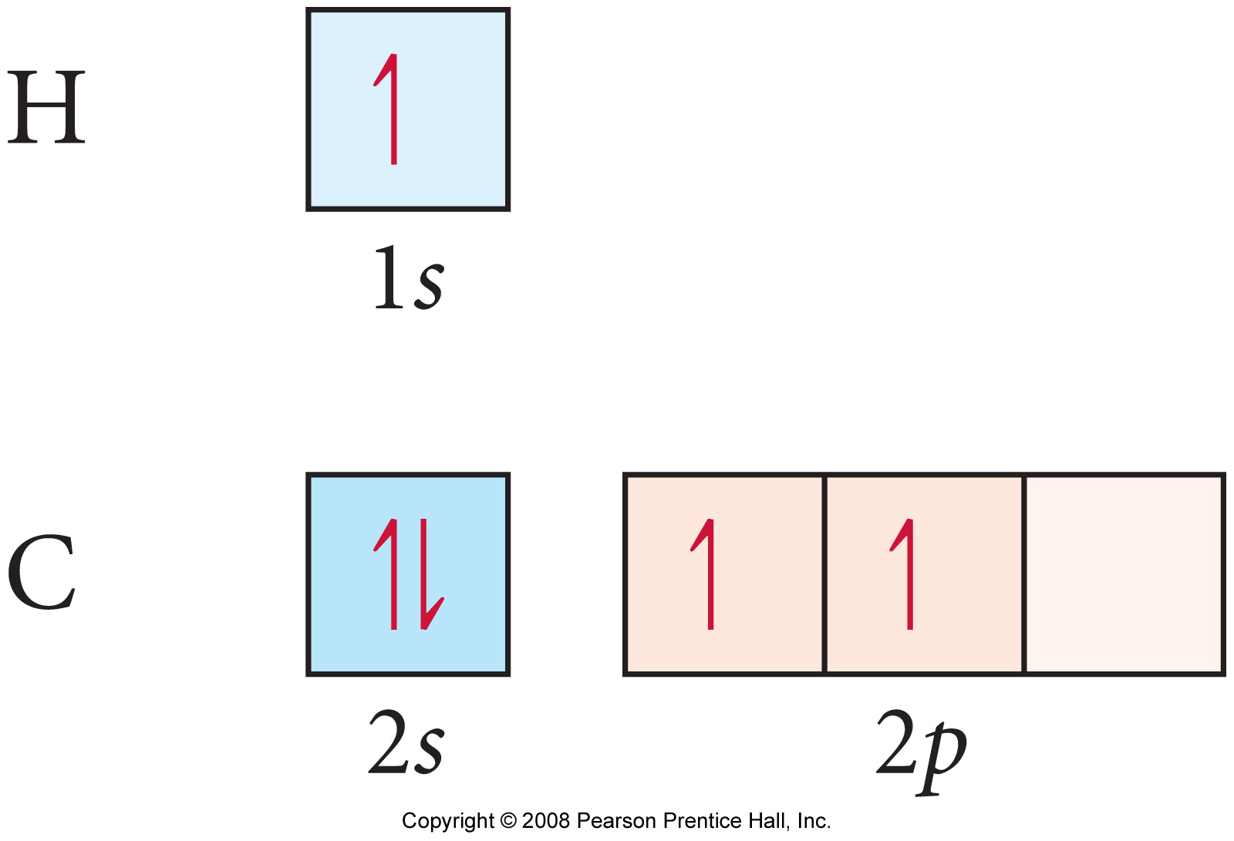
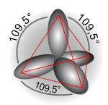
Valence Bond Theory: Hybridization
It was postulated that the valence atomic orbitals could hybridize before bonding took place
one hybridization of C is to mix all the 2s and 2p orbitals to get 4 orbitals that point at the corners of a tetrahedron

Slide 9
Valence Bond Theory: Hybridization
Key Points
The number of hybrid orbitals obtained equals the number of atomic orbitals mixed.
The type of hybrid orbitals obtained varies with the types of atomic orbitals mixed.
Types of Hybrid Orbitals
sp
sp²
sp³
sp³d
sp³d²

Slide 10
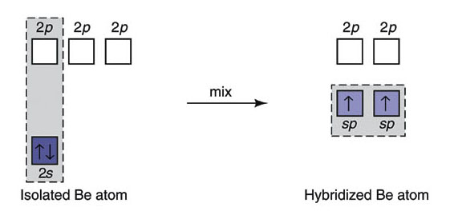
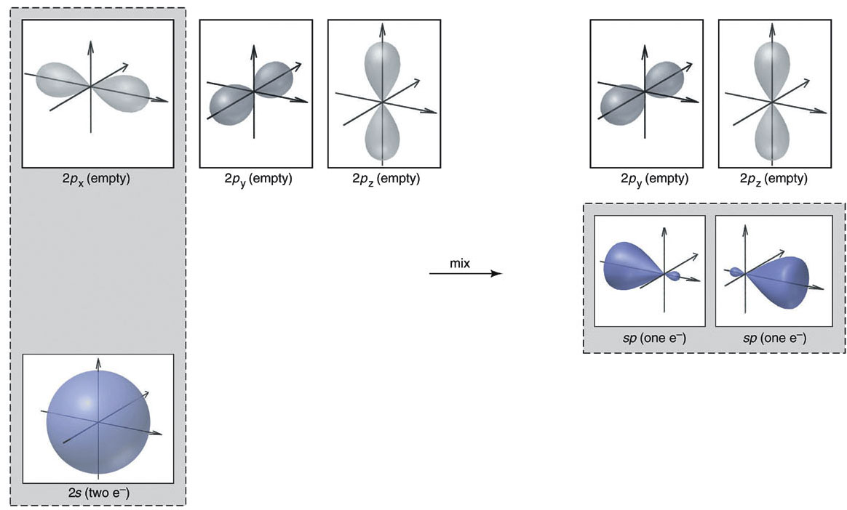
Valence Bond Theory: Hybridization
The sp hybrid orbitals in gaseous BeCl₂

Slide 11
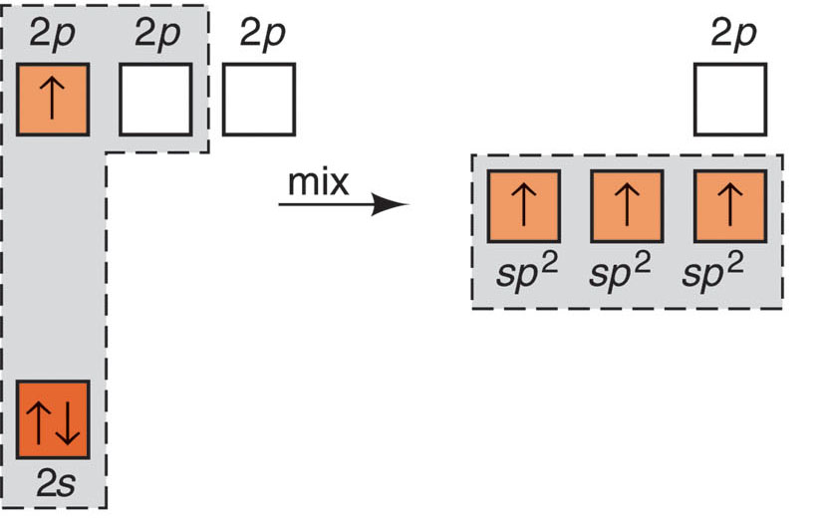
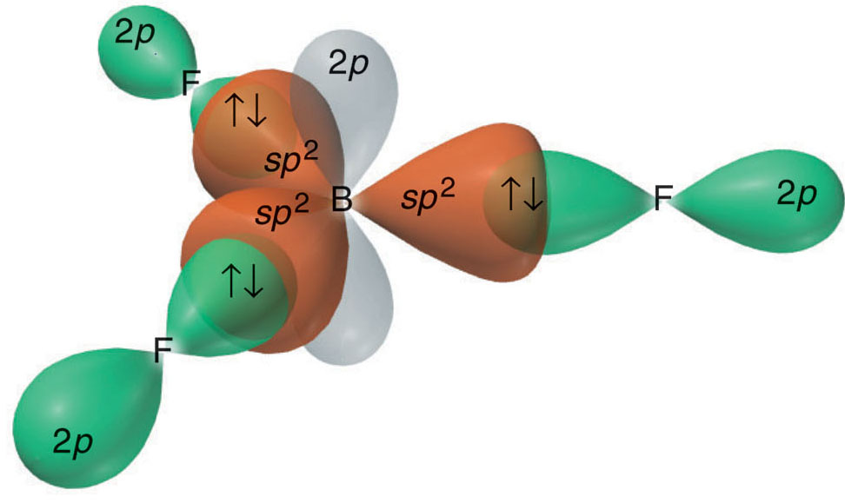
Valence Bond Theory: Hybridization
The sp² hybrid orbitals in BF₃.

Slide 12
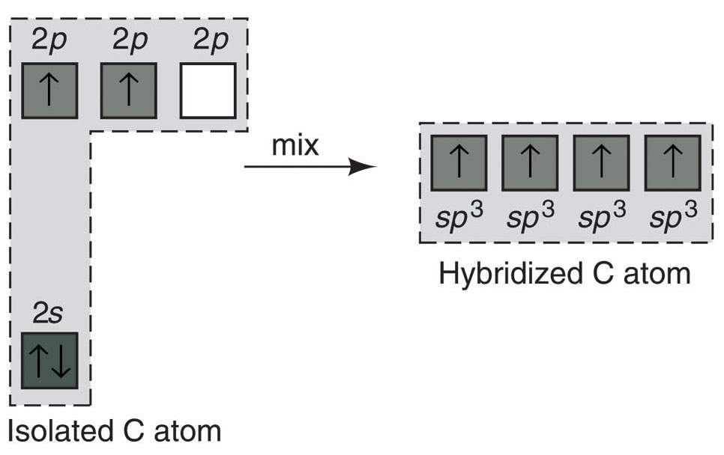
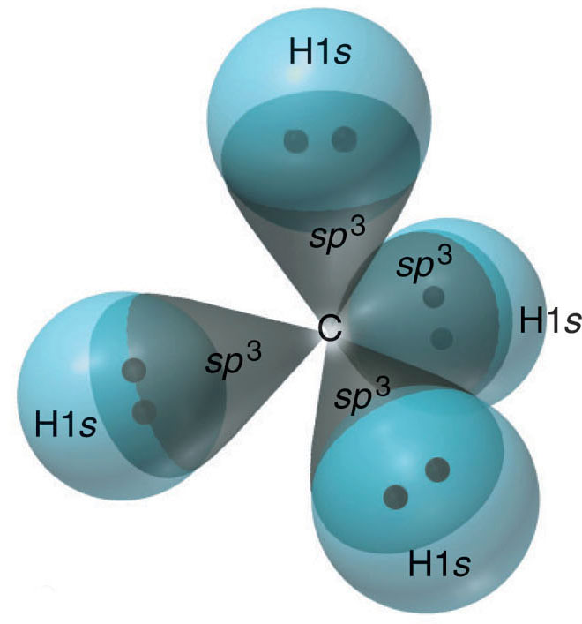
Valence Bond Theory: Hybridization
The sp³ hybrid orbitals in CH₄.

Slide 13
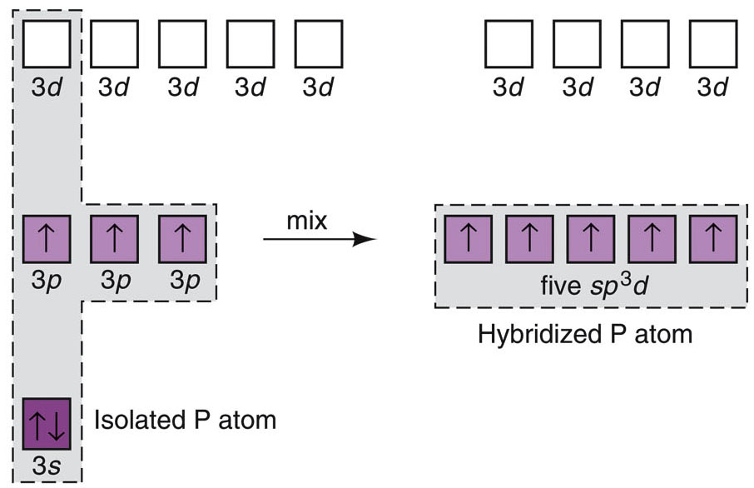
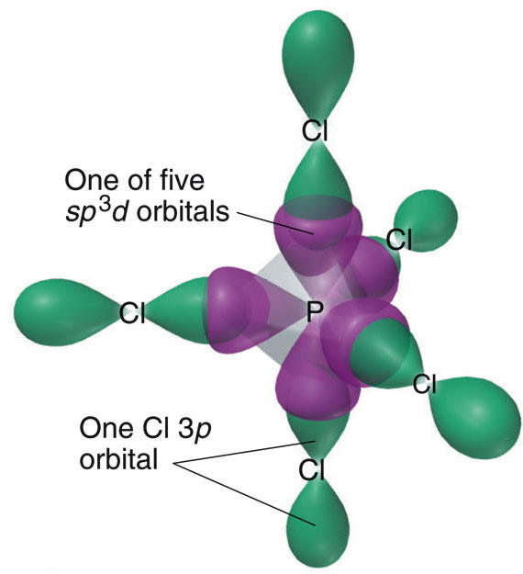
Valence Bond Theory: Hybridization
The sp³d hybrid orbitals in PCl₅.

Slide 14
Valence Bond Theory: Hybridization
The conceptual steps from molecular formula to the
hybrid orbitals used in bonding.
Step 1
Step 2
Step 3
Molecular shape and e⁻ group arrangement
Molecular formula
Lewis structure
Hybrid orbitals
What is the hybridization on the N atom in NO₂⁻ and in NO₃⁻?
a. sp² for NO₂⁻ and sp³ for NO₃⁻ b. sp³ for NO₂⁻ and sp² for NO₃⁻ c. sp for NO₂⁻ and sp² for NO₃⁻ d. sp² for both
→ Do the same between CO₂ and CO₃²⁻

