Slide 1
Transition Metals: Structure and Bonding
General Chemistry II Chem2333

Slide 2
Transition Metals
Module 6 – Session 6
Video 1: Molecular Orbitals of a transition metals
Color: energy difference between HOMO and LUMO
Video 2: Different kinds of spectroscopy
Radiative and non-radiative transitions
Video 3: Color and absorption of conjugated systems
Bathochromic shift

Slide 3
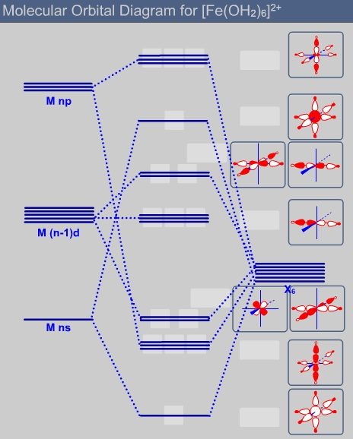
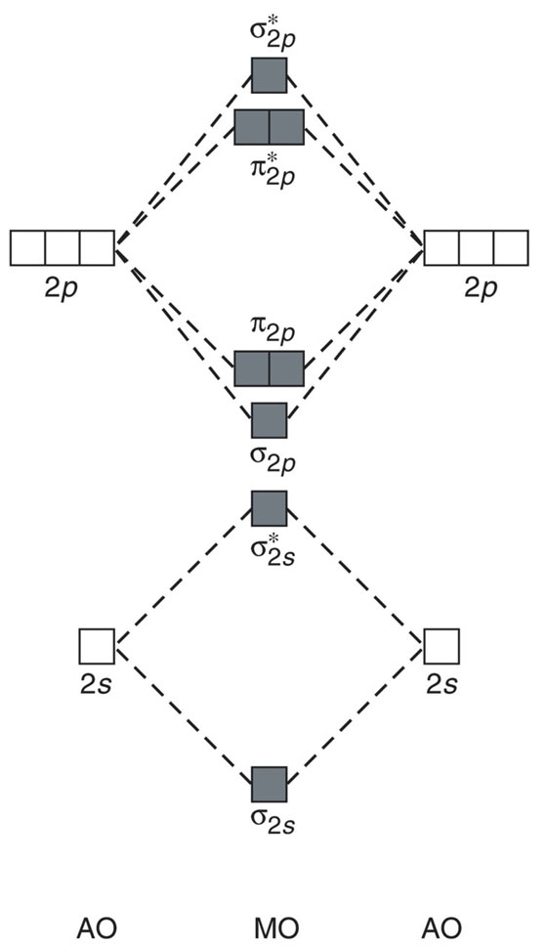
HOMO/LUMO

Slide 4
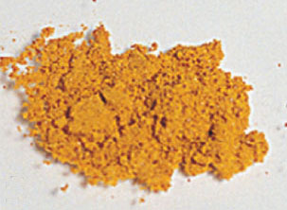
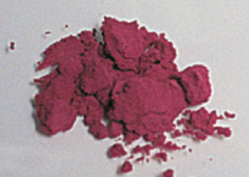
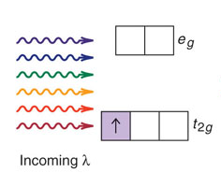
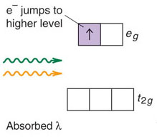
HOMO/LUMO: color
[Cr(NH₃)₆]³⁺
[Cr(NH₃)₅Cl ]²⁺
Most electronic transitions fall in the UV region of the spectrum, but the smaller difference between the HOMO and LUMO in coordination compounds makes them very colorful.

Slide 5
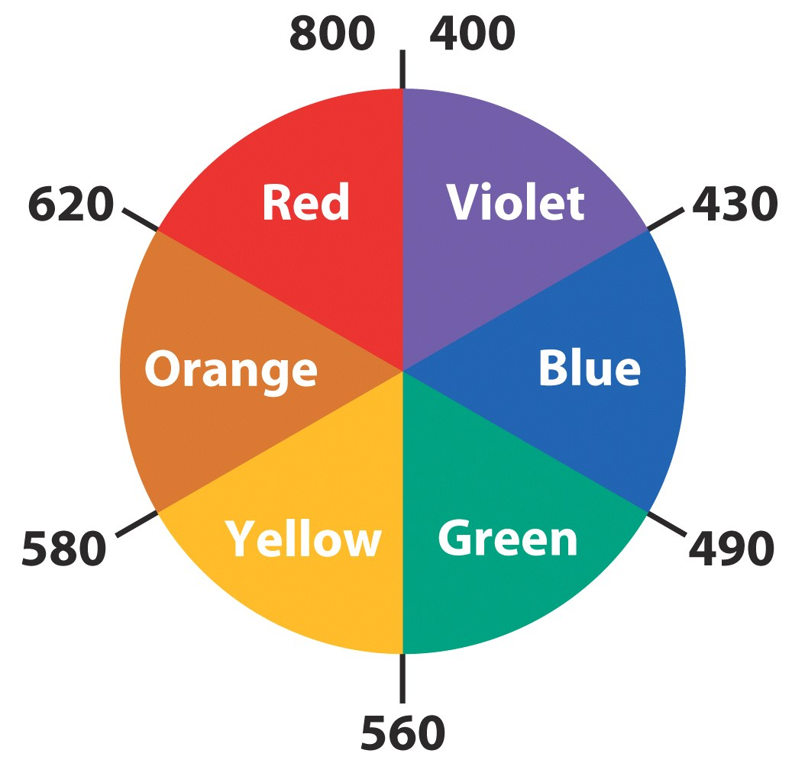
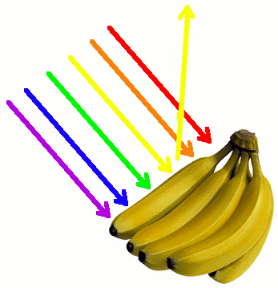
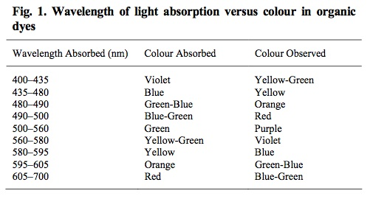
Color absorbed and color reflected
We don’t see the color that is absorbed, but the color that is reflected
→A pigment is blue and another one is yellow.
Which one has the smallest energy between HOMO and LUMO?
Notes:
Source: http://monographs.iarc.fr/ENG/Monographs/vol99/mono99-7.pdf

Slide 6
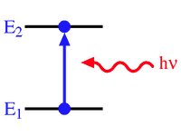
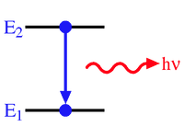
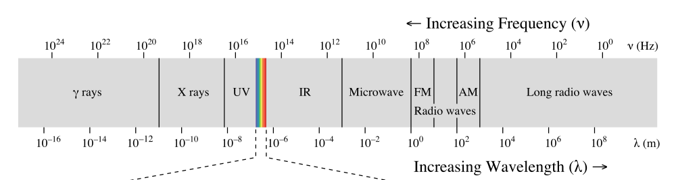
Spectroscopy: interaction of light and matter
Absorption of light
Emission of light
More energy
Less energy
Valence electronic levels (molecular orbitals): Ultraviolet/visible spectroscopy
Core inner electrons (X-ray, CT-scan…)
Vibrational levels : Infrared spectroscopy
Rotational levels: Microwave spectroscopy
Nuclear spin transition: Nuclear Magnetic Resonance (NMR, MRI)
Electronic spin transition: Electronic Spin Resonance (ESR)

Slide 7
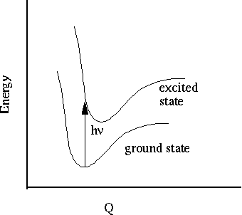
Electronic curves
+
=

Slide 8
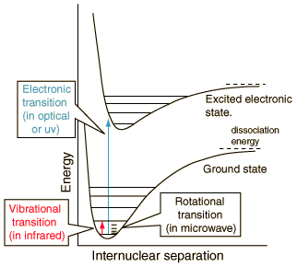
UV/Visible spectroscopy
Most transitions between molecular orbitals fall in the UV/Visible range
Once the molecule relaxes, (comes down from the excited state) shouldn’t we see a photon being emited?
Why is it that we talk about light being absorbed but rarely about light being emmited?
Notes:
Credits: http://hyperphysics.phy-astr.gsu.edu/hbase/molecule/molec.html
Credits: http://www.files.chem.vt.edu/chem-dept/brewer/chem-ed/4414/tutorials/electronic/ELECTRON.HTML

Slide 9
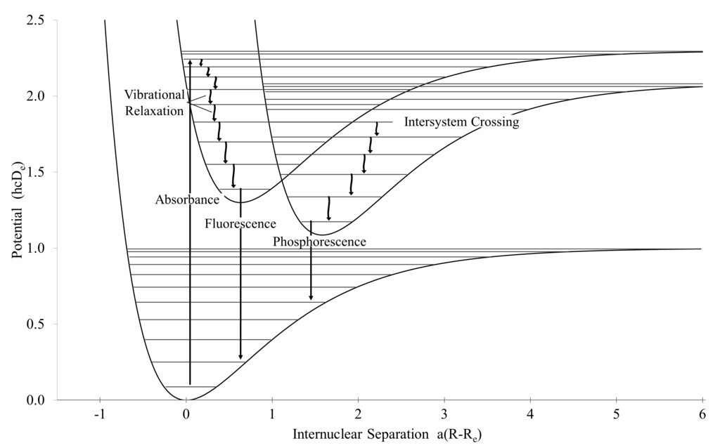
Radiative and non-radiative transitions
Jablonski diagram.
Substances irradiated with UV light that emit visible light are called fluorescent.
The relaxations with energy in the IR are called “non-radiative” transitions: IR waves is heat.
Notes:
http://en.wikipedia.org/wiki/Intersystem_crossing#/media/File:Electronic_Processes_Involving_Light.png

Slide 10
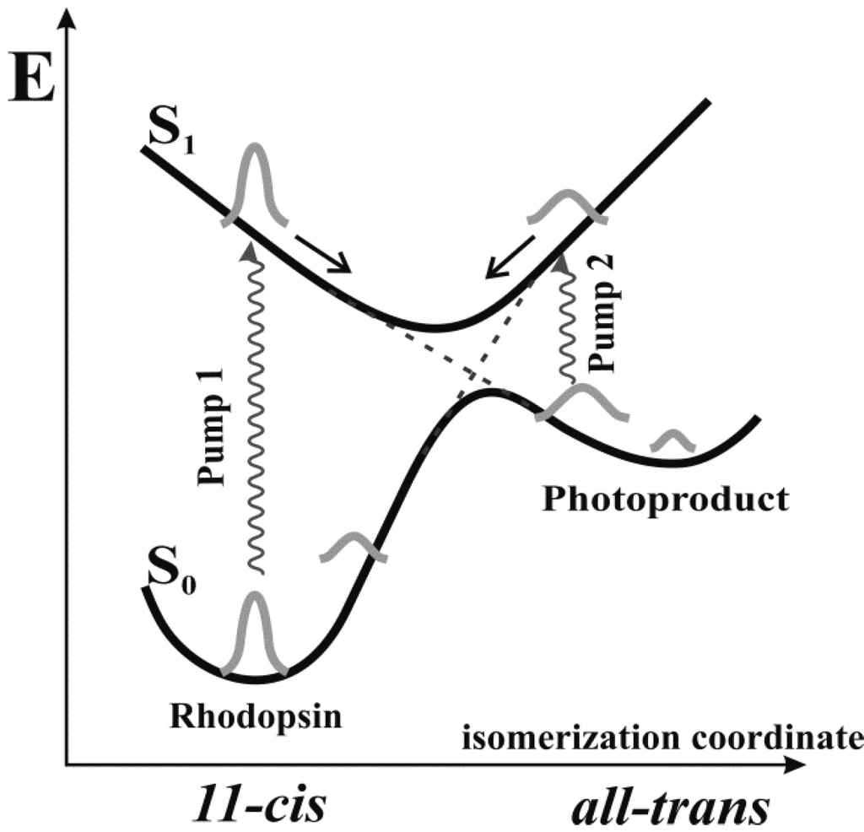
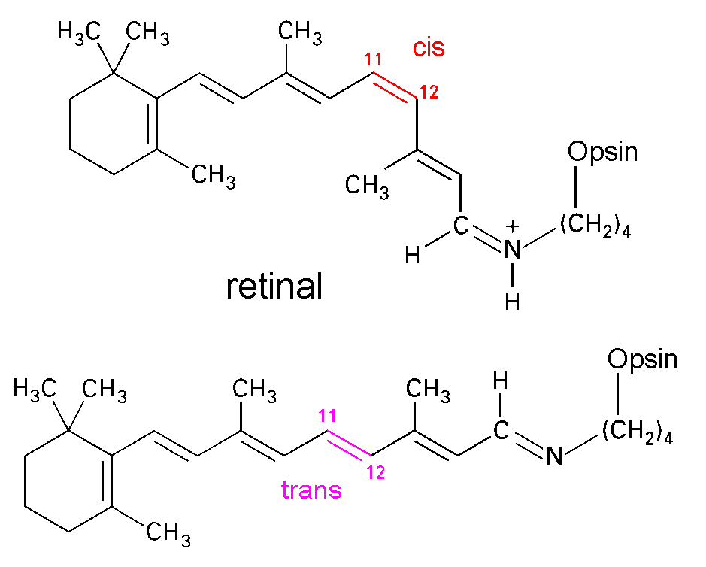
Retinal: photo-induced reactions
Response

Slide 11
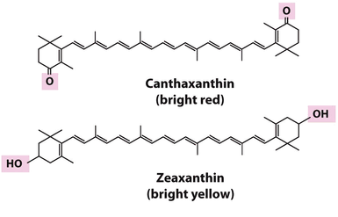
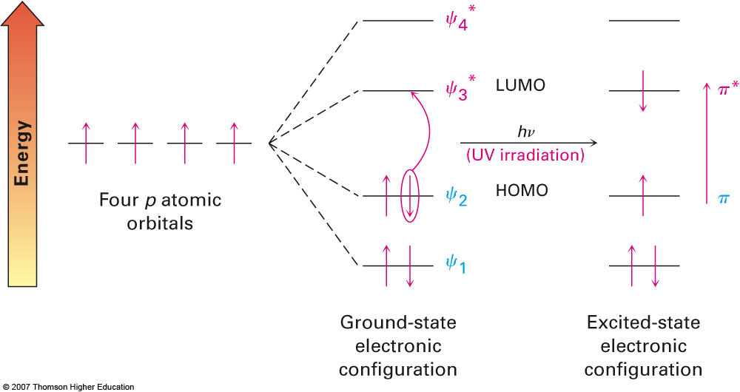
HOMO/LUMO in conjugated systems
Most pigments in nature are conjugated systems.
Do you think that the frequency of the absorbed light will increase or decrease with the length of the conjugated system?
Notes:
Source: Lehninger’s Principles of biochemistry

Slide 12
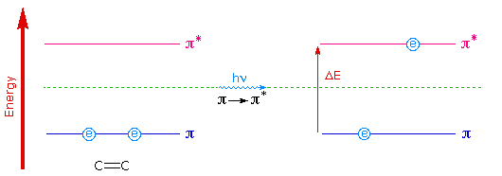
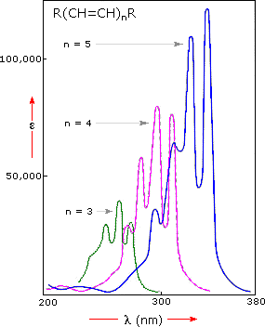
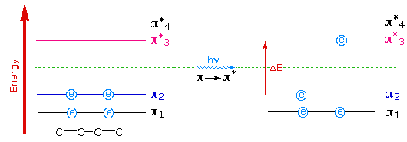
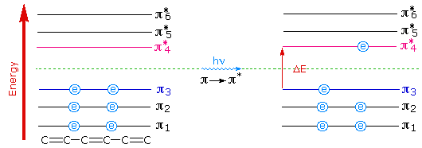
HOMO/LUMO in conjugated systems
1 double bond
2 double bonds
(conjugated)
3 double bonds (conjugated)
Notes:
Credits: http://www2.chemistry.msu.edu/faculty/reusch/VirtTxtJml/Spectrpy/UV-Vis/spectrum.htm

Slide 13
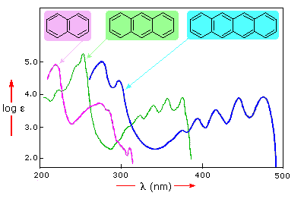
Bathochromic shift
Bathochromic shift:
The more conjugated a system is the smaller the homo-lumo is and the less energetic the electronic transition is. (larger wavelength or smaller frequency)
Notes:
Credits: http://www2.chemistry.msu.edu/faculty/reusch/VirtTxtJml/Spectrpy/UV-Vis/spectrum.htm

Slide 14
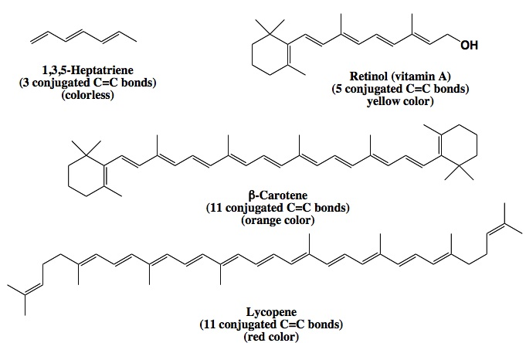
Color of natural pigments
Draw a qualitative scheme showing the energetic difference between the HOMO and LUMO of the following pigments
Notes:
Source: http://people.chem.umass.edu/samal/269/color.pdf

