Slide 1
Transition Metals: Structure and Bonding
General Chemistry II Chem2333

Slide 2
Transition Metals
Module 6 – Session 7
Video 1: Ligand field theory
Octahedral field
Spectrochemical series
Video 2: Ligand field theory: magnetism
Low spin and high spin complexes
Video 3: LIgand field theory: other fields
Tetrahedral
Square planar
Video 4: Problem solving

Slide 3
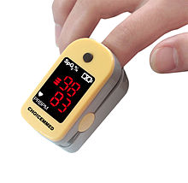
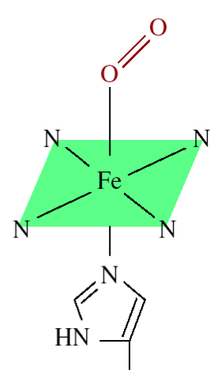
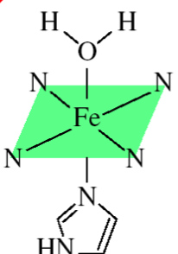
Detecting Hypoxia
The Pulse Oxymeter is a device to detect oxygen saturation in patient’s tissue.
It’s a small spectrophotometer
Oxyhemoglobin
Deoxyhemoglobin
Absorbs at 660nm (color red)
Absorbs at 940nm (color blue/purple)

Slide 4
Crystal field theory (CFT)
4p
CFT focuses on this part only
Vanadium: V
3d
6 H₂O
2p
4s
Electronic transition outside of the d orbital will be too energetic, beyond visible light

Slide 5
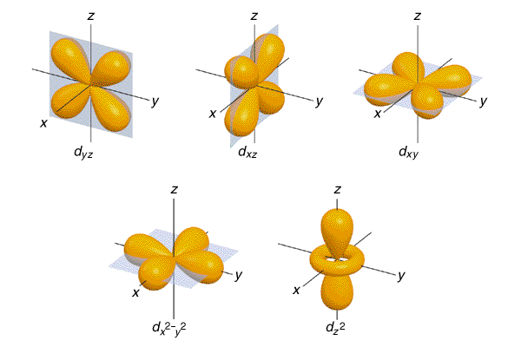
d-Orbitals
Absent ligands the
orbitals are degenerate,
they have the same energy...
Ligand Field Theory: An electrostatic model
(i.e. not technically a bonding model)
It will attempt to explain what happens to the
Molecular Orbitals in Coordination Compounds.
(sometimes called Crystal Field Theory)
Notes:
Consider MO’s (use sp3d2)
HOMO & LUMO

Slide 6
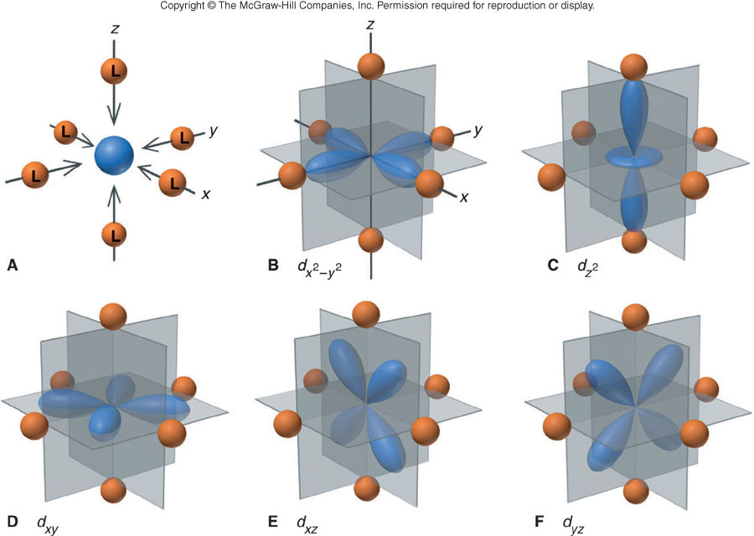
Ligand Field Theory
What is the electrostatic (+/-) nature of the ligand?
What is the electrostatic (+/-) nature of an orbital?
Will each d-orbital increase or decrease in energy?

Slide 7
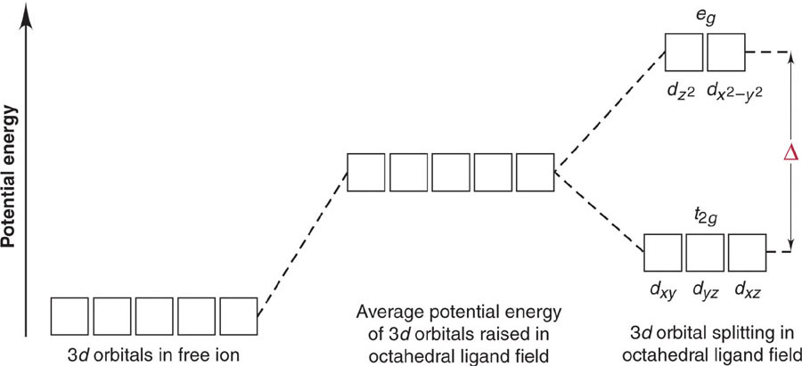
Octahedral Ligand Field
Oh
ΔOh is the Ligand Field Splitting energy. In this case an octahedral ligand field (Oh). The size of ΔOh depends on the ligands and will determine spectroscopic and magnetic properties.

Slide 8
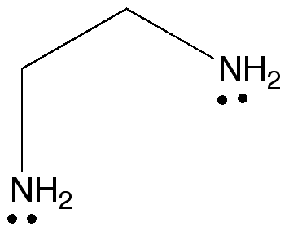
Spectrochemical Series
weak field ligand
increasing
strong field ligand
small Δ
large Δ
Bidentate ligand –
binds twice to the metal ion
en =
Derived from measurements

Slide 9
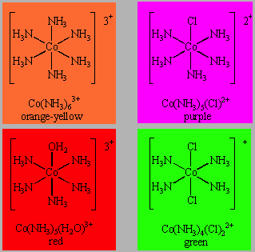
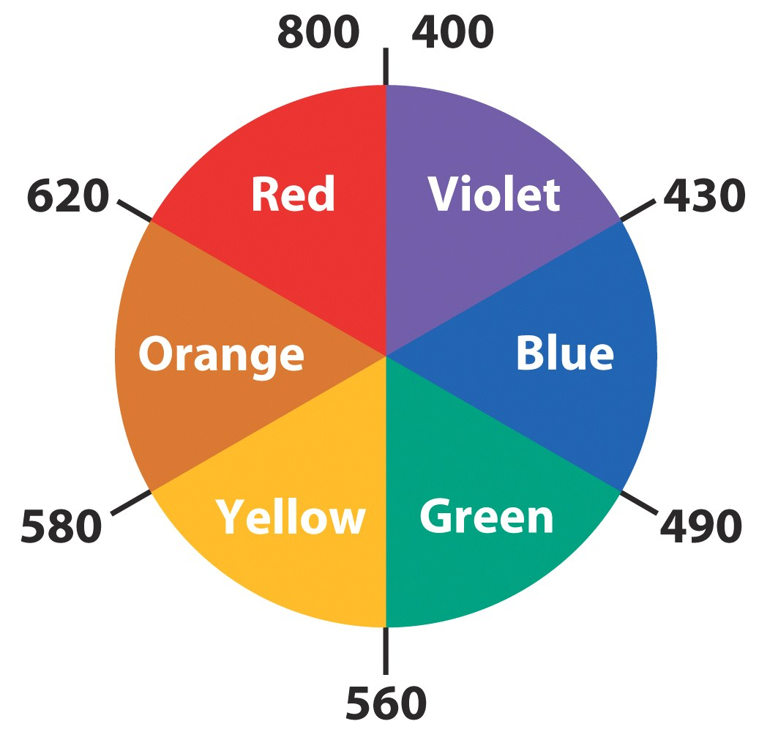
Spectrochemical Series
Numbers are nm
→ So which compound has a larger Δ split?
9

Slide 10
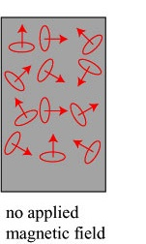
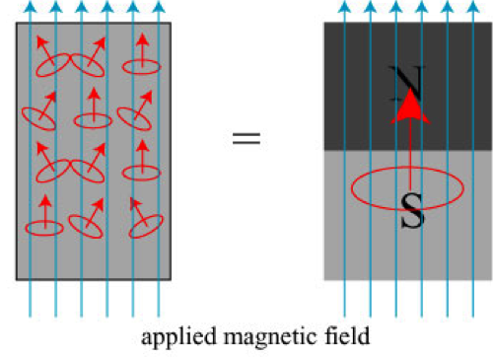
Magnetism
Bulk: many molecules
Even if a substance has unpaired electrons, the molecular “electron spins” are randomly pointing to all the directions and no net magnetic field is produced.
Only when we apply an external magnetic field (with a magnet) the electron spins align and a magnetic field is induced. (Think of the refrigerator magnets)
NMR works in a similar way
but with nuclear spins.
Some paramagnetic substances are able to keep this alignment (all molecule’s spins pointing to one direction) even when no external magnetic field is applied. This is the case of some compounds of Fe, Co, Ni. They are called ferromagnetic and they are used as magnets.

Slide 11
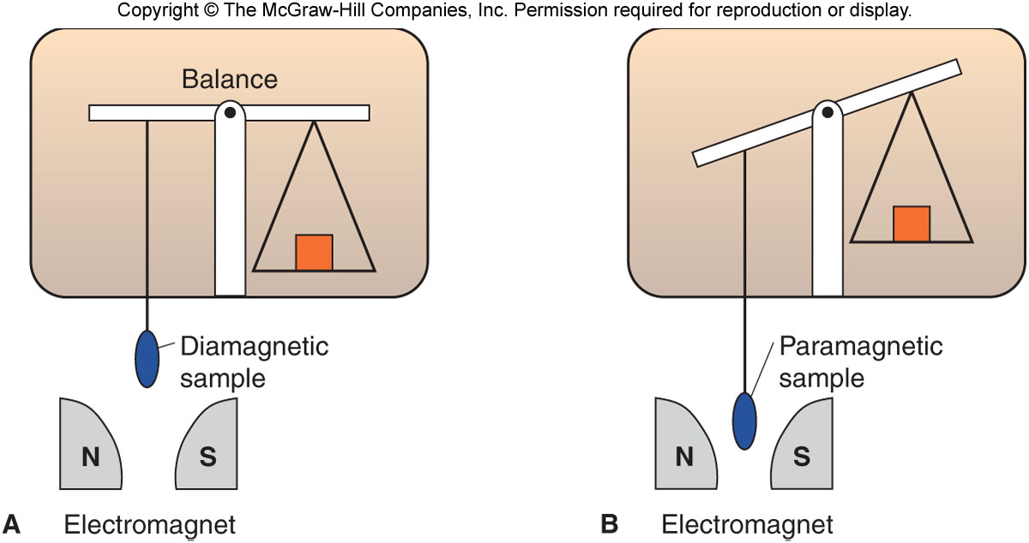
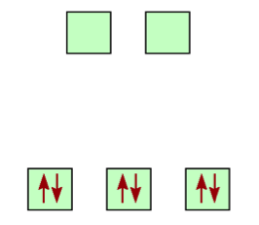
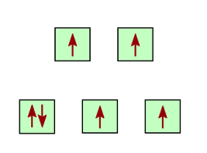
Magnetism
Some substances are attracted by an external magnetic field (e.g. magnet) and they are called paramagnetic. Other substances are not attracted and they are called diamagnetic.
Paramagnetic substance will have unpaired electrons. The molecule will generate a net magnetic field
Diamagnetic substance won’t have any unpaired electrons

Slide 12
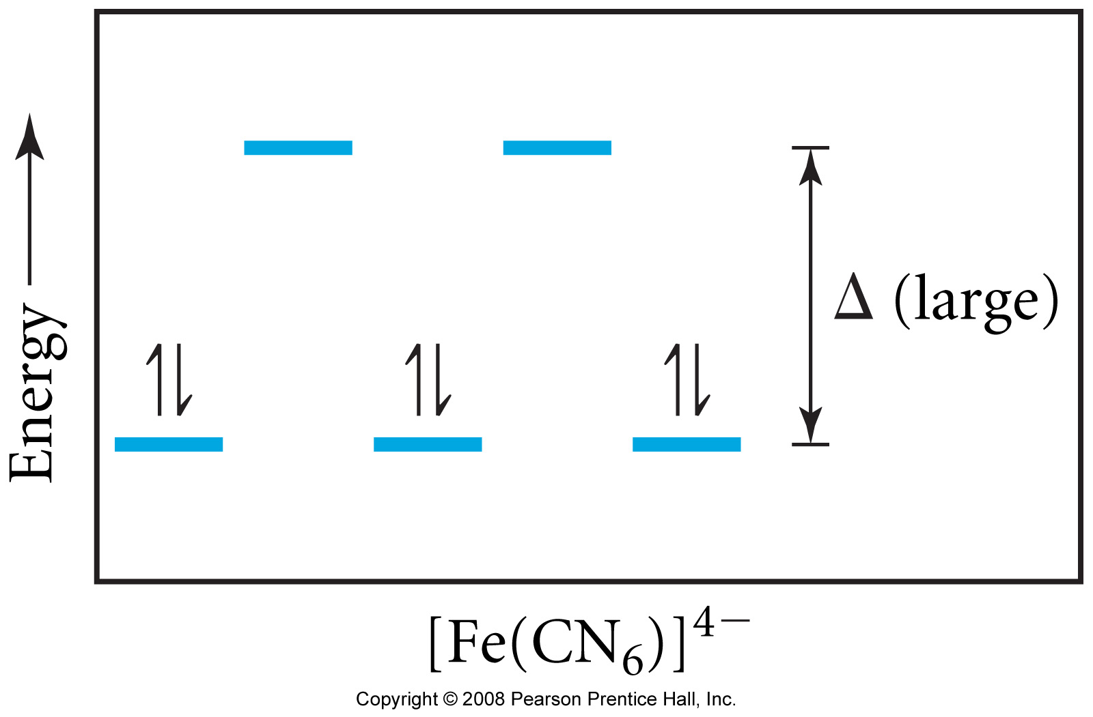
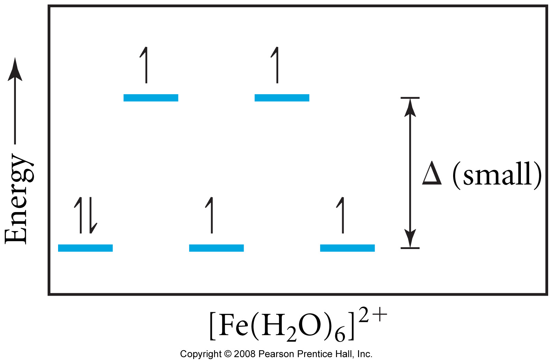
Low-Spin and High-Spin Complexes
Coulomb interactions are stronger than Pauli exclusion principle (Aufbau wins!)
Pauli exclusion principle is stronger than coulomb interactions (Pauli wins!)
diamagnetic
paramagnetic
low-spin complex
high-spin complex
only electron configurations d⁴, d⁵, d⁶, or d⁷ can have low or high spin

Slide 13
Low-Spin and High-Spin Complexes
Draw the possible low spin and high spin electronic configurations in octahedral complexes for the following number of d electrons:
d4:
d5:
d6:
d7:

Slide 14
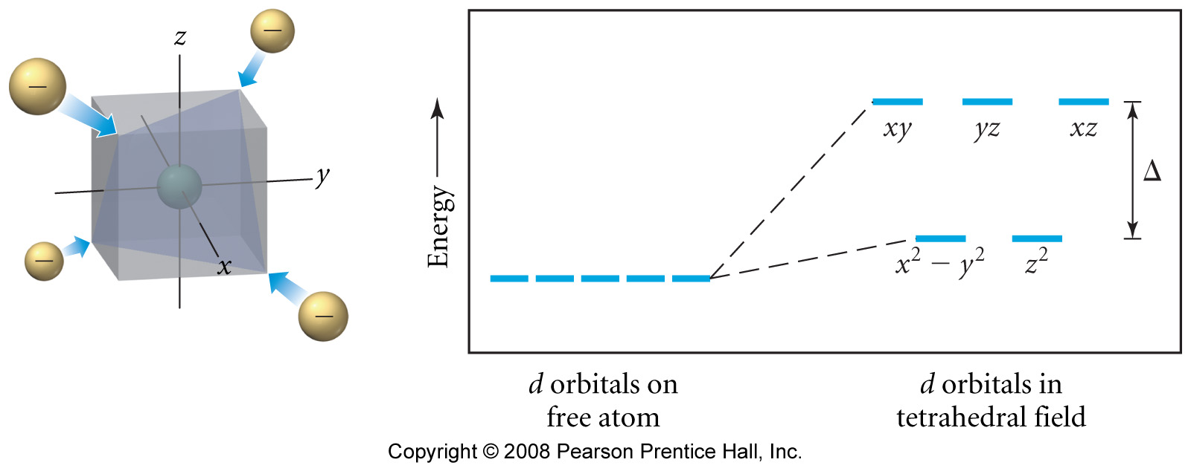
Crystal field theory: Tetrahedral
In general the orbital splitting in tetrahedral will be much lower than in octahedral
Δ_{tetrahedral} < Δ_{octahedral}
Only high-spin tetrahedral complexes are known

Slide 15
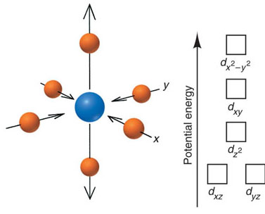
Crystal field theory: Square planar

Slide 16
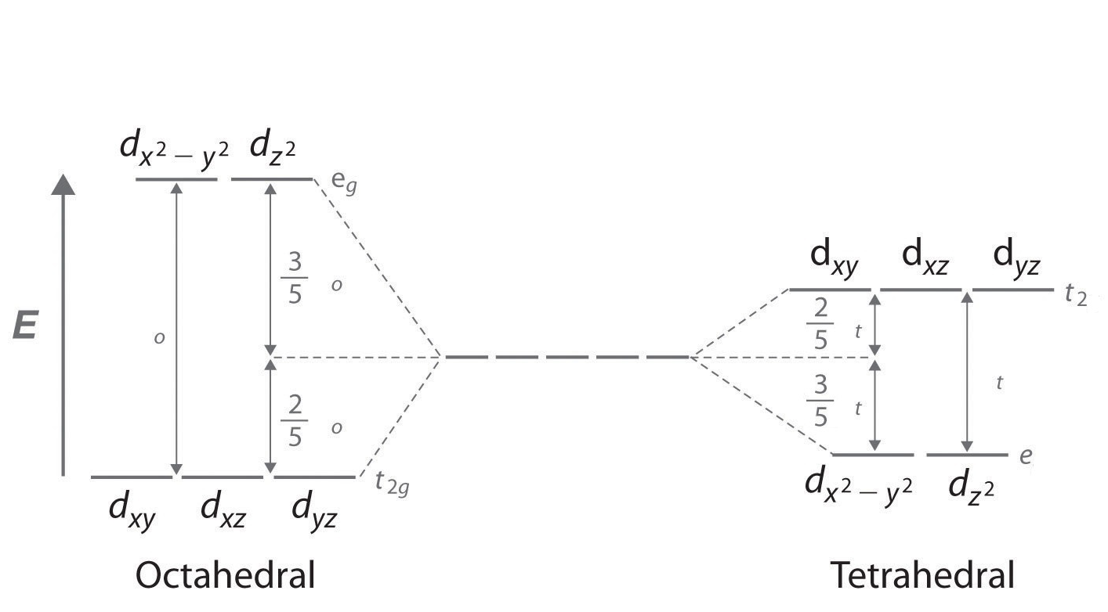
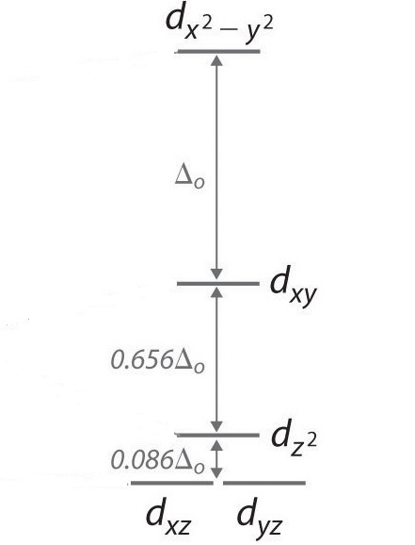
Δt=0.44Δo
Small split in Tetradhedral No low spin complexes
Δ_{sp}=1.74Δ_{o}
For a tetrahedral complex to be stable it has to have more electrons in the “e” level than “t”
Most square planar complexes are d8.
What is the electronic configruation in cisplatin (one of the first cancer drug).

Slide 17
Crystal field theory: problem solving
→The absorption maximum for the complex ion [Co(NH₃)₆]³⁺ occurs at 470 nm. What is the color of the complex and what is the crystal field splitting in kJ/mol?

Slide 18
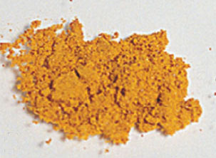
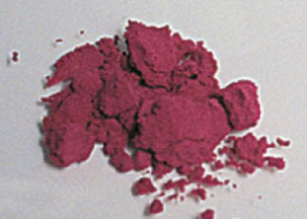
Crystal field theory: problem solving
Explain the differences in color of these two compounds:
[Cr(NH₃)₆]³⁺
[Cr(NH₃)₅Cl ]²⁺
Numbers are nm

Slide 19
Crystal field theory: problem solving
What color would we expect an aqueous solution containing Ti(OH₂)₄⁴⁺ to be?
1. blue
2. red
3. green
4. yellow
5. colorless

